Slide 1


LEARN. COOK. ENJOY.
YOUR FUTURE IS THE BEST INVESTMENT

Slide 2
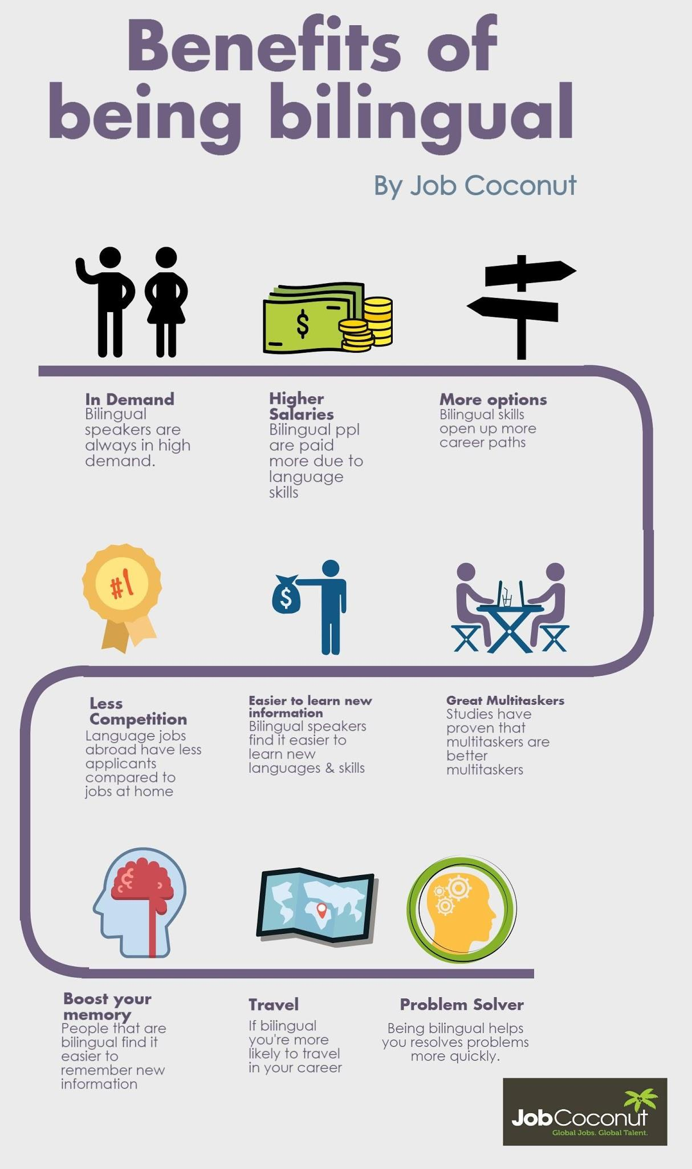

Slide 3
WHAT CAN WE OFFER YOU ?
2 LEVELS OF LEARNING ( BASIC LEVEL, PROFESSIONAL ENGLISH + COOKING)
QUALIFIED TEACHERS
MODERN TECHNICS
ABILITY TO SPEAK WITH NATIVE SPEAKER
CHANCE TO GET THE JOB ON THE PROFESSIONAL KITCHEN ( FOR 2D LEVEL)
GOOD PRICE
THE BEST PROGRAM FOR THE BEST COOK

Slide 4


Slide 5
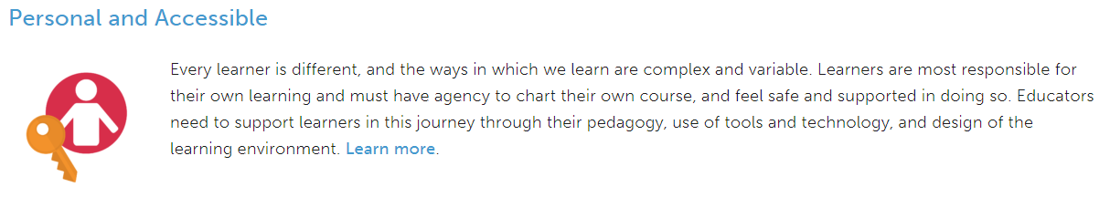
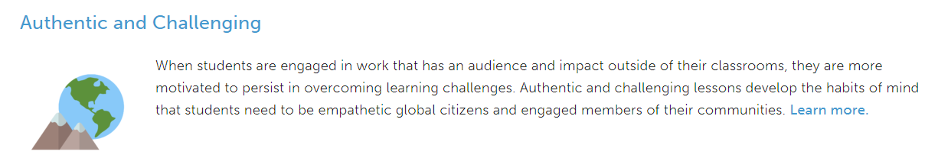
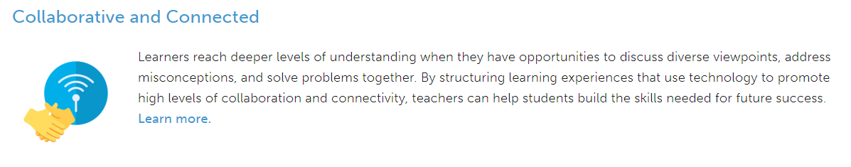

Slide 6
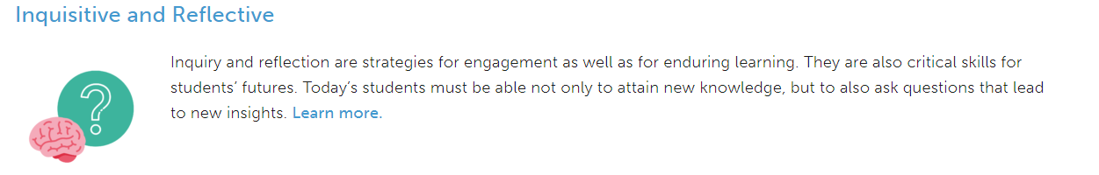


Slide 7

WE COOPERATE WITH THE HEAD-CHIEFS AROUND THE WHOLE WORD

Slide 8
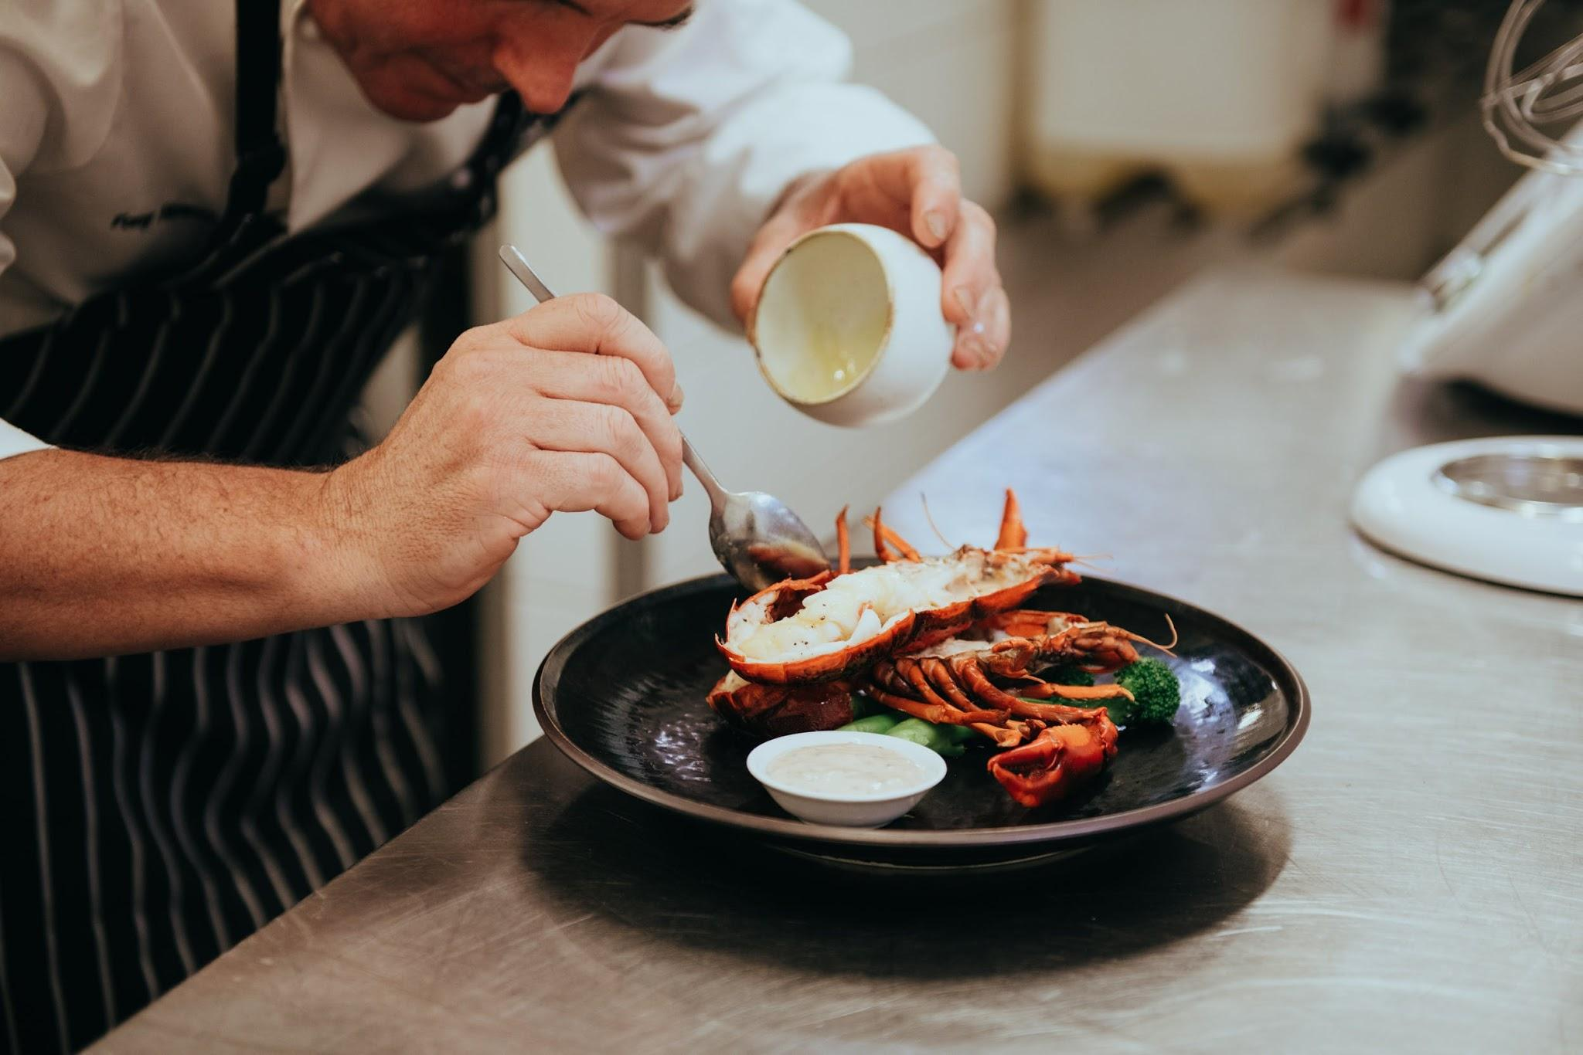
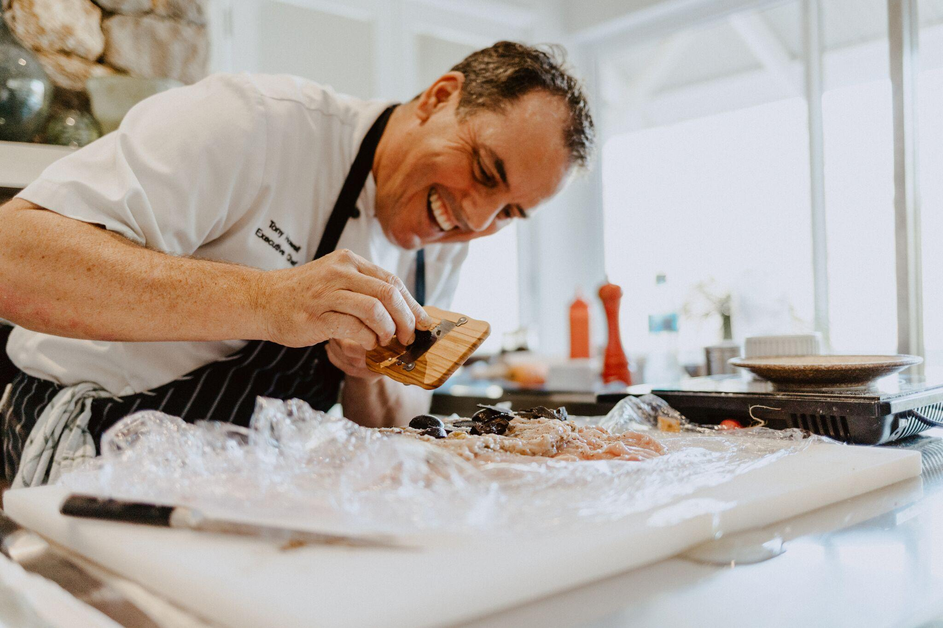
WHAT DOES IT MEAN FOR YOU ?

Slide 9

WHERE WE ARE LOCATED?
WHEN DO WE WORK ?

Slide 10
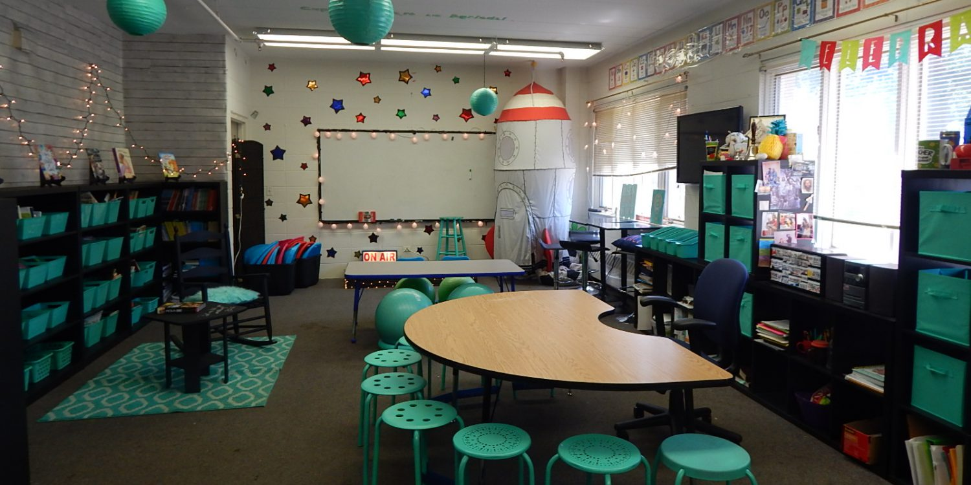

Slide 11
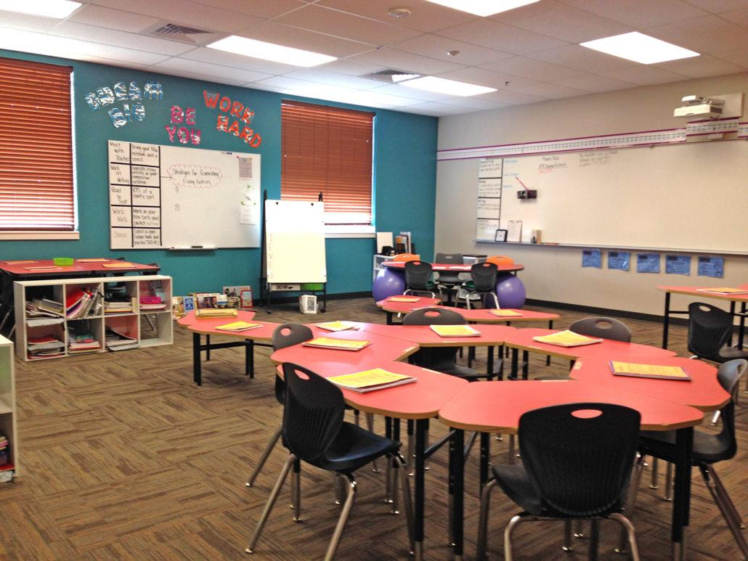

Slide 12
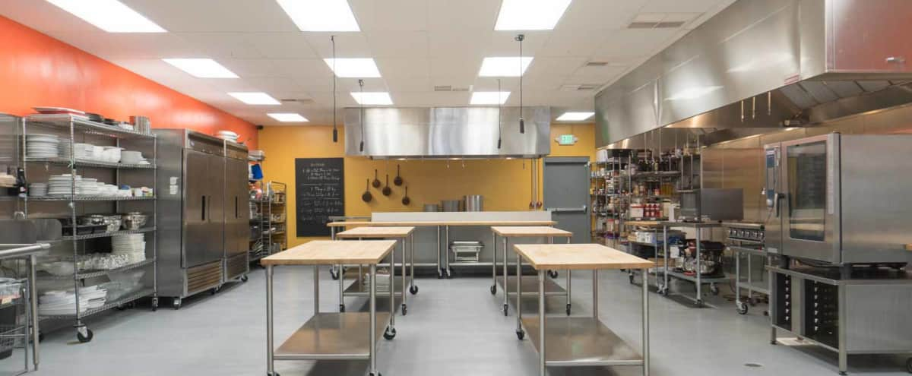

Slide 13


Slide 14

THANKS FOR YOUR ATTENTION !!!

