Slide 1
understanding action research
New generation school teacher project: preset curriculum reform

Slide 2
OBJECTIVES
to enable students to:
identify the role of research in learning and teaching;
explore teacher research and its varieties;
identify the notion steps and stages of action research;
define the focus of the study;
formulate a research question.

Slide 3


Slide 4
What problems and challenges did you have during your teacher assistantship? How did you deal with them? Did you carry out any research To cope with them? What steps did you take? Who/what helped you to find a solution?

Slide 5

“Flavours” of teacher research
Action research
Self-study
TEACHER RESEARCH
Reflective practice?
Exploratory practice

Slide 6
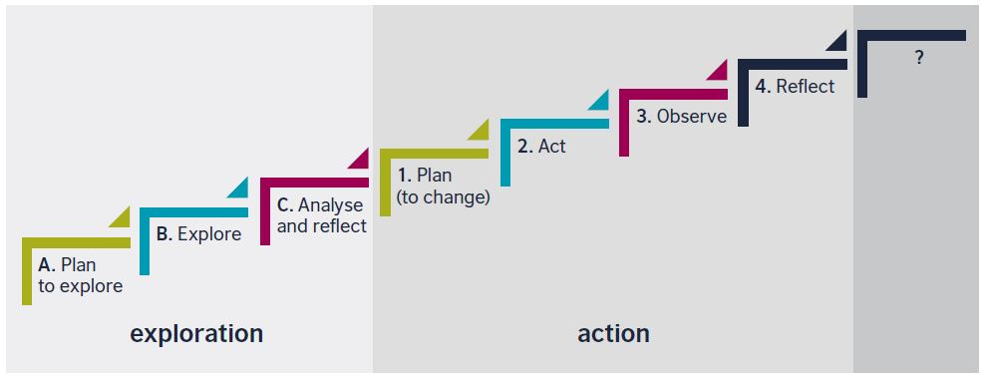
action research steps

Slide 7
CRITERIA FOR PROBLEM FORMULATION
A GOOD PROBLEM IS ….
A GOOD PROBLEM IS ….
A GOOD PROBLEM IS ….
A GOOD PROBLEM IS ….
A GOOD PROBLEM DEMANDS….
A GOOD PROBLEM RAISES….
A GOOD PROBLEM LEADS TO….

Slide 8
CRITERIA FOR PROBLEM FORMULATION
A Good Problem is Important
A Good Problem is Complex
A Good Problem is Multi-functional
A Good Problem is Difficult
A Good Problem Demands Action
A Good Problem Raises Specific Research Questions
A Good Problem Leads to Surprises

Slide 9
RESEARCH QUESTIONS
S
M
A
R
T
tudy-oriented
easurable
ccurate
ealistic
opic-focused

Slide 10


