Slide 1
Why children are cruel?
Has prepared
Нmelivska Hrystyna

Slide 2
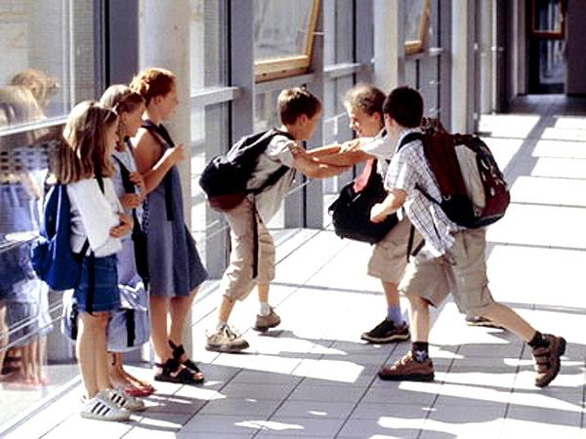
Say psychologists,ukrainian children increasingly become victims of bullying their peers. According to UNICEF, every fourth child in school is subjected to physical or psychological violence.

Slide 3
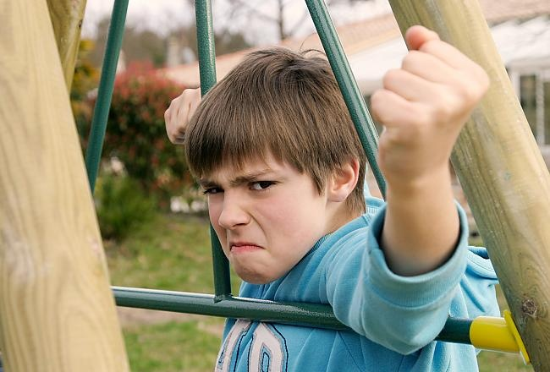
Most often brutal children are the result of improper parenting. Mentality, rude and unworthy parental behavior, physical punishment of the child, verbal humiliation of him - the most common reasons for the manifestation of childhood cruelty. For cruelty people are inherent in nature, it is laid down in us for millions of years of evolution, during which man has learned to survive in order to maintain his appearance. As a result of many years of education and a constant example of parents, people learned how to control their original instincts and emotions.

Slide 4
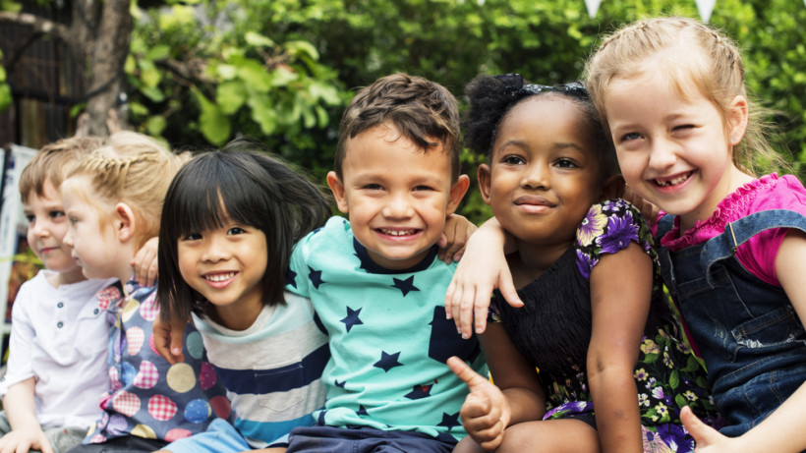
I think generally kids are the most humane of all humans, they can play with just about any other child, regardless of their ethnicity or color or intelligence level. Even young children will show empathy for another child if he or she gives visible signs of distress like crying. But today, children increasingly show brutality to their peers.

Slide 5
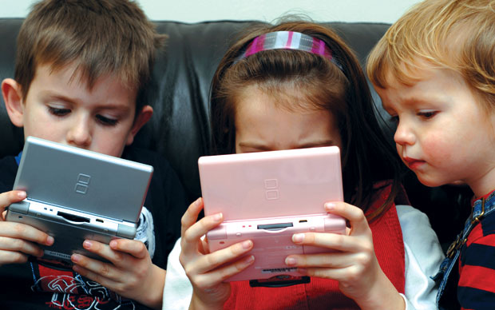
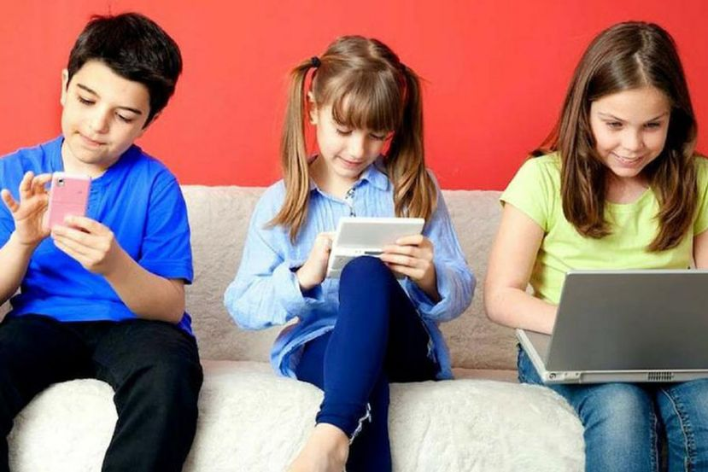
The causes of aggressive behavior in children can be different. Starting from watching adult programs on the TV and ending with the aggressive behavior of adults in the family. The child repeats vivid examples, pictures that he sees in life. In addition, children through their age are still poorly controlled by emotions.

Slide 6

When six-year olds point out physical flaws they are simply responding to their own curiosity. They have no idea that this might hurt people.
To realize the impact of these observations would require the ability to be in someone else's head. This is why children can be so cruel to classmates who are different. They will point to, or laugh at, physical or psychological differences simply because they stand out

Slide 7
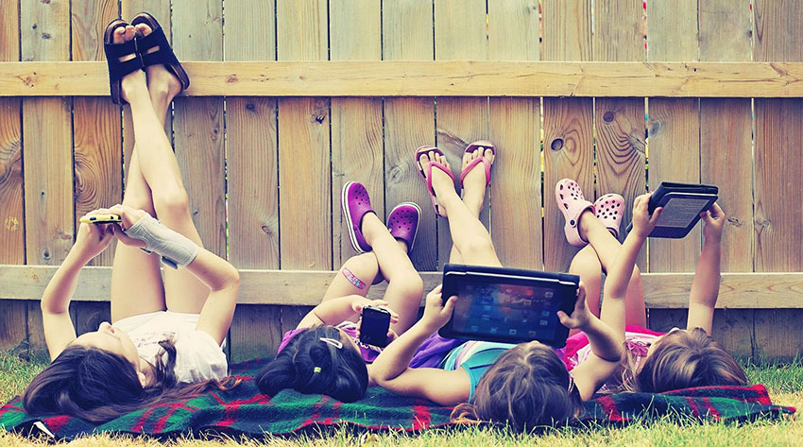
In recent years, psychologists say children have become brutal. Children under 13 years of age are the most affected. According to psychologists, social networks, computer games, movies and TV programs - promote violence

Slide 8
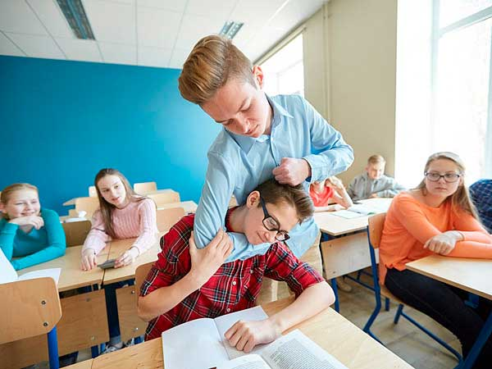
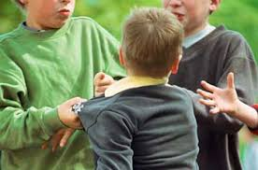
The brutality of the child also causes the situation at home. Children become witnesses of intercourse between parents, take on the manner of their communication, seen as being reproduced at school.

Slide 9
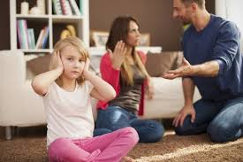
Another option for the emergence of brutality - the upbringing of the child practically nobody is engaged. She tries to attract attention, get a piece of tenderness and love.

Slide 10


Parents of brutal children should contact a psychologist to choose the right tactics in the upbringing. It is difficult for these children to be re-educated, but to make parents obey their parents and persuade them not to do anything. They never forget the image and believe that everything should be as they wish. During the fight, they cheat and cling to the abuser with a deadly grasp that can not break even adults.

Slide 11
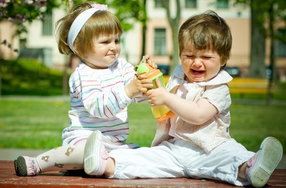
It's easy to advise parents, and it's often impossible to do this. After all, it is rarely possible for someone to constantly monitor the child and prohibit him from watching action movies, walking on the street with bad children, sitting at the computer and playing aggressive games.

Slide 12

Unfortunately, the cause of child abuse can be not only the family, but also kindergarten, school, friends, cartoons, books, internet and movies. Under the influence of all these factors, the feelings of regret of children dull, and force becomes the norm of problem solving. It is only possible to prevent their influence by protecting children from sources of harmful information.

Slide 13
Thank you!

