Slide 1
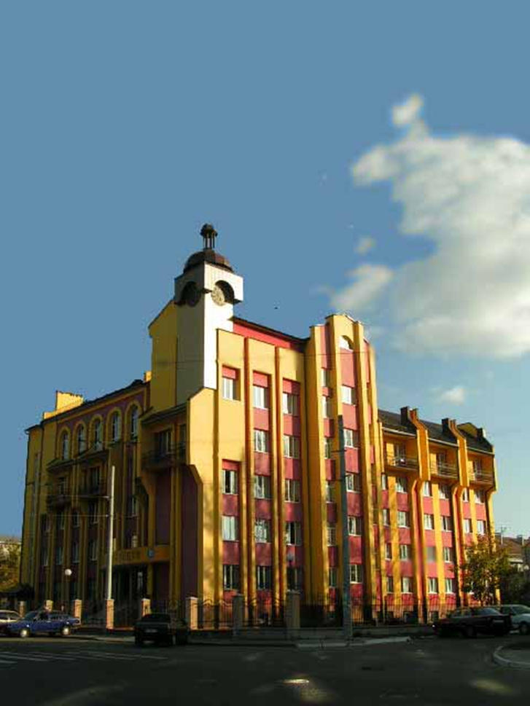
VASYL STEFANYK PRECARPATHIAN NATIONAL UNIVERSITY
In June 2002, based on SHEE "Carpathian National University V.Stefanik" to continue the glorious traditions of Western Ukraine in the field of professional music education was created Department of Performing Arts, which helped to attract talented young people to actively and aggressively creative work, improving their natural talents, acquiring professionalism.
Today the Department works closely with higher musical educational institutions of Ukraine, Romania and Italy. Graduates work in leading orchestral and theatrical groups Ukraine, Hungary, Poland, Spain and Italy.

Slide 2
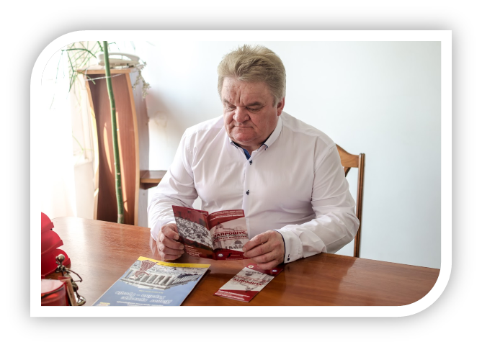
Petro Krul
Petro Krul - Doctor of Arts, Professor, Academician of the Academy of Higher Education of Ukraine, head of performing arts SHEE "Carpathian National University named after V. Stefanik."
Author of three books sole:
. "Synthesized Performance - unique creative process" (Kyiv, 1996);
"National Ukrainian art tool spiritual people" (Kyiv, 2002);
"Instrumental history of the Eastern culture: historical origins and functioning" (inventor's certificate).
The author of the textbook for higher music education level IV
accreditation "brass instrument music culture in the history of Ukraine" (Kyiv, 2013) and more than one hundred twenty articles in scientific journals and books.
Co-author of the scientific international project "The Problem of the spiritual world of Euro-Carpathian region: the cultural aspect."
Developed and reading courses "Fundamentals of the theory of performing arts", "History of performing arts in orchestral wind and percussion instruments", “organ science " postgraduate specialty "Music Art".

Slide 3
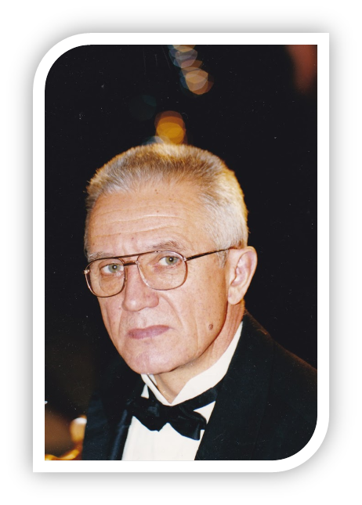
Dorozhivskyy Ruslan
Dorozhivskyy Ruslan G. - Honored Artist of Ukraine, Associate Professor, Professor of Performing Arts, Educational and Research Institute of the Arts SHEE "Carpathian National University named after V. Stefanik"
1970 - graduated from Lviv State Conservatory named Lysenko, qualified as "conductor of opera and symphony orchestra."
He worked as a conductor at the Opera House Franko (Lviv), State Symphony Orchestra of the USSR (Kiev), State Academic Opera and Ballet Theater of Kyiv (Kiev), head and conductor of opera training department of the National music Academy named after Tchaikovsky. From 1995 to 1999 - director, artistic director and chief conductor of the Lviv Opera and Ballet Theater named after Ivan Franko.
1987. received the honorary title of Honored Artist of Ukraine and the rank of associate professor.
Since 1999 Professor of the Department academically and instrumental performing arts institution V.Stefanik Carpathian National University, Head of Student Symphony Orchestra (since 2008, the orchestra received the status Philharmonic Symphony Orchestra)
Touring, Poland (Zabrze, bitumen, Krakow), Spain (Madrid, Murcia), Turkey (Ankara), Russia (Moscow), Azerbaijan (Baku).
Reads: Science about musical instruments ; The instrumentation and translation; Orchestral conducting; Orchestral class.
https://www.youtube.com/watch?v=NOfeKPyCazA
https://www.youtube.com/watch?v=5wmy_DrYJg8
https://youtu.be/6Lnc6BCaucw

Slide 4
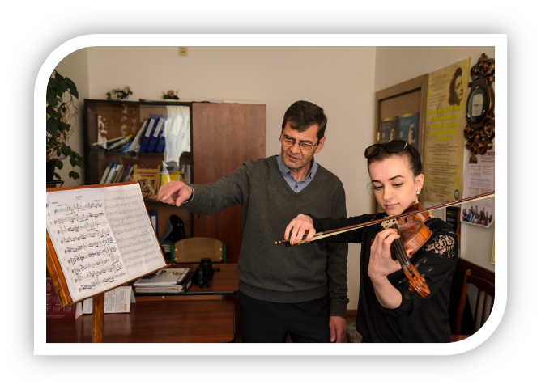
Szyptur Roman
Senior Lecturer
Graduated Lysenko Lviv State Conservatory in 1977, produced 14 winners of international and national competitions (international competition "The Little Prince" (Zaporizhia) contest "New Names" Ukrainian Cultural Foundation (Kyiv)), three Winner of the Grand Prix international competition of orchestral instruments ("Silver bells" (Uzhgorod), "Crimean spring" (Yalta)).
Teacher viola, violin.
https://www.youtube.com/watch?v=8HJKAyr8MjM
https://www.youtube.com/watch?v=9JaLjBZNNQ4
https://www.youtube.com/watch?v=p6B8-WYGoHk
https://www.youtube.com/watch?v=Zy4RtKWlBns

Slide 5
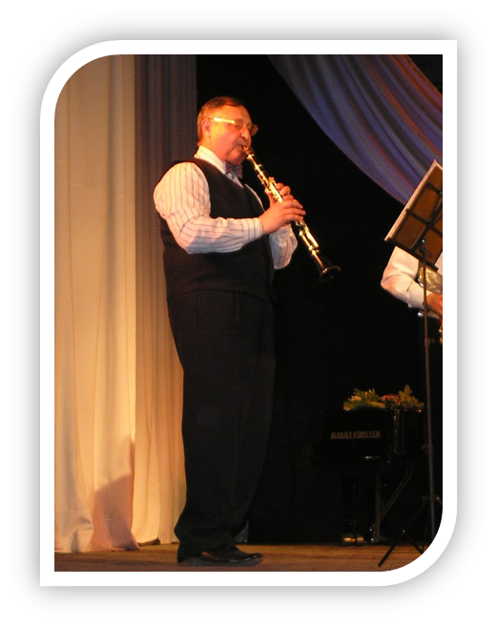
Alexander Melnik
Alexander Yulianovich Melnyk - Associate Professor, Honored Worker of Culture of Ukraine. He graduated from Lviv State Conservatoire. Lysenko (qualification - the soloist of the orchestra teaching the clarinet), since 2000 year he working in the educational institute of arts SHEE "Carpathian National University named V. Stefanik."
In order methodical study of the Ministry of Culture and Tourism of Ukraine, prepared to release a program of training courses "musical object saxophone and clarinet music object" and his "Collection for the play saxophone" is widely used in schools of aesthetic education and specialized artistic educational institutions of Ukraine.
Pupils O. Melnyk gained recognition at prestigious competitions, earning the title of winners: Ukrainian competition "New Names of Ukraine" (Kyiv) named V. Starchenko (c. Rivne), International Competition "Silver Bells" (c. Uzhgorod) them. D.Bidy (c. Lviv), "Academic and contemporary music" (c. Kahn), "Young Performers" (c. Chernovtsy).
EJ Miller a permanent member of the jury performers on wind and percussion instruments "Young Virtuoso", "Concertino" and Ukrainian music reviews and competitions.
https://www.youtube.com/watch?v=0Mz6FcvOXao
https://www.youtube.com/watch?v=9Cwv5_fWxjk
https://www.youtube.com/watch?v=8Ja18HpNWkU
https://www.youtube.com/watch?v=nQz_q3KmAPI

Slide 6
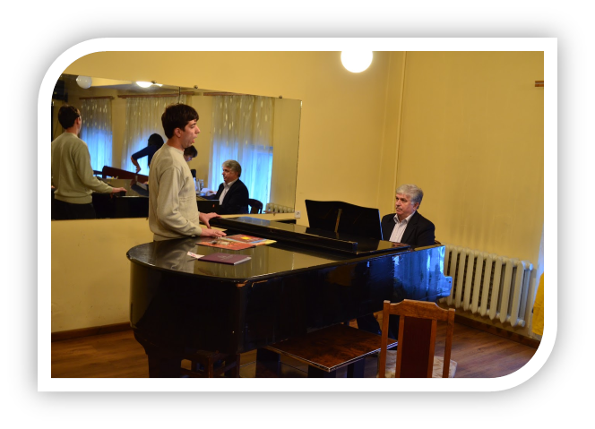
Stefanyuk Mikhailo
Senior lecturer Performing Arts Education and Arts Research Institute SHEE "Carpathian National University named V. Stefanik."
Graduated Lysenko's Lviv State Conservatory in the class of solo singing, trained winners of international and national competitions (International Competition for Young Opera Singers in c.Lempaala (Finland), International Competition for singers in c.Fodzha (Italy), Ukrainian contest of young performers named .Iryny Malanyuk in Ivano-Frankivsk, International contest "Slavonic bazaar" Vitebsk (Belarus), "New wave" c.Yurmala (Latvia), International competition named A.Dvorzhaka International contest "Retro-fest" (Italy) and International competition .Poludonnyh (Yalta), International Competition namaed .F.Shalyapina (Yalta), among them - 10 Winner of the Grand Prix.
The teacher of solo singing.
https://www.youtube.com/watch?v=w3PcuD_L8TQ
https://www.youtube.com/watch?v=18ZYcaO4FHs&list=PLy64XBFsvRFBFJEio7GJQKgx7ZWzk0Cn4&index=2
https://www.youtube.com/watch?v=g2dJB7ut9tk&list=PLy64XBFsvRFBFJEio7GJQKgx7ZWzk0Cn4&index=3
https://www.youtube.com/watch?v=DGcXJYySfCo&index=4&list=PLy64XBFsvRFBFJEio7GJQKgx7ZWzk0Cn4
https://www.youtube.com/watch?v=ieTtZskpLZY&index=7&list=PLy64XBFsvRFBFJEio7GJQKgx7ZWzk0Cn4
https://www.youtube.com/watch?v=NB3BF-cIY9o&index=9&list=PLy64XBFsvRFBFJEio7GJQKgx7ZWzk0Cn4
https://www.youtube.com/watch?v=iOXYNKd6E0M&index=11&list=PLy64XBFsvRFBFJEio7GJQKgx7ZWzk0Cn4

Slide 7
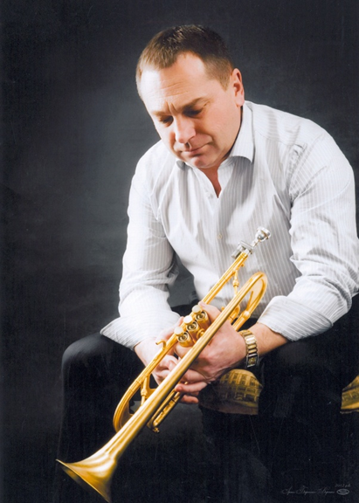
Vakalyuk Petro
Candidate of Art, Associate Professor of Performing Arts Education and Arts Research Institute SHEE "Carpathian National University named after V. Stefanik."
Graduated Lysenko Lviv State Conservatory in the class of pipe produced 15 winners of international and national competitions (International competition of brass instruments named after St. Hanycha International Competition for Young Trumpet named after .M.Starovetskoho International competition of brass named after .V.Starchenka instruments), of which - two winner of the Grand Prix.
In 2010 he received the Scholarship Award in. Trossinhen (Germany).
https://www.youtube.com/watch?v=E9tELOTaFZw
https://www.youtube.com/watch?v=HRjdK-kSW7A

Slide 8
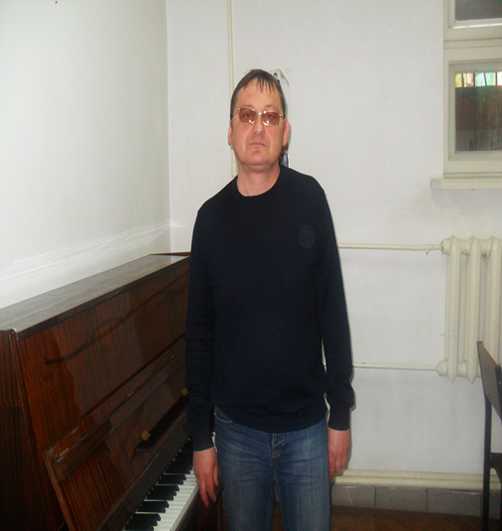
Kolomiec Taras
Senior lecturer Performing Arts Education and Arts Research Institute SHEE "Carpathian National University named after V. Stefanik."
1994. - graduated from Kiev State Conservatory named after P. Tchaikovsky,
1997. - executive graduate studies at the high school c.Aahen (Germany)
He worked in the National Presidential Orchestra, the Kiev National Operetta Theater, the orchestra of the Defense Ministry of Ukraine, Philharmonic children (Kiev).
Since 2005 - the teacher SHEE "Carpathian National University V.Stefanik" since 2008 - combining teaching the game as part of a symphonic orchestra Philharmonic (Ivano-Frankivsk).
Among his students - the winner of the international competition Crimean Spring 2012, winner of the international competition named after Starchenko (Rivne), winner of the international competition Crimean Spring 2012, winner of the international competition named Bidy (Lviv), winner of the international competition bassoonist (c.Vrotslav , Poland)
https://www.youtube.com/watch?v=2oHGOti6DPQ&feature=youtu.be
https://www.youtube.com/watch?v=90vW0b9xRCI

Slide 9
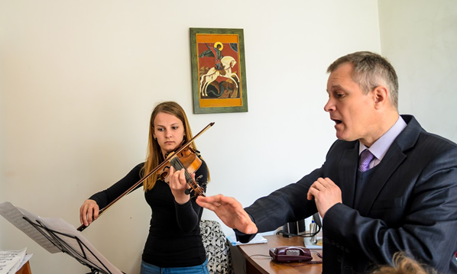
Yuri Voloshchuk
Ph.D., associate professor.
Developed and reads the following courses: History, Theory and Methods of performing arts, cultural music, special musical instrument (violin).
Voloshchuk Y. - the author of a manual "Ukrainian violin art" (2008), the textbook "violin performing arts Eastern Galicia second half XIX - the first third of the twentieth century: national traditions and polyethnic cultural relations" (2012, approved by the Ministry of Education and Science, youth and sports of Ukraine).
During the university, led by Y. Voloshchuk successfully defended 18 master's theses and PhD thesis A.Y.Kornyeva "Heroism Khmelnytsky as cultural and artistic paradigm XVII - XIX centuries."
In the scientific achievements of Y.I.Voloschuk are also three scientific brochures and more than thirty scientific articles on the problems of theory and history of performing arts.

Slide 10
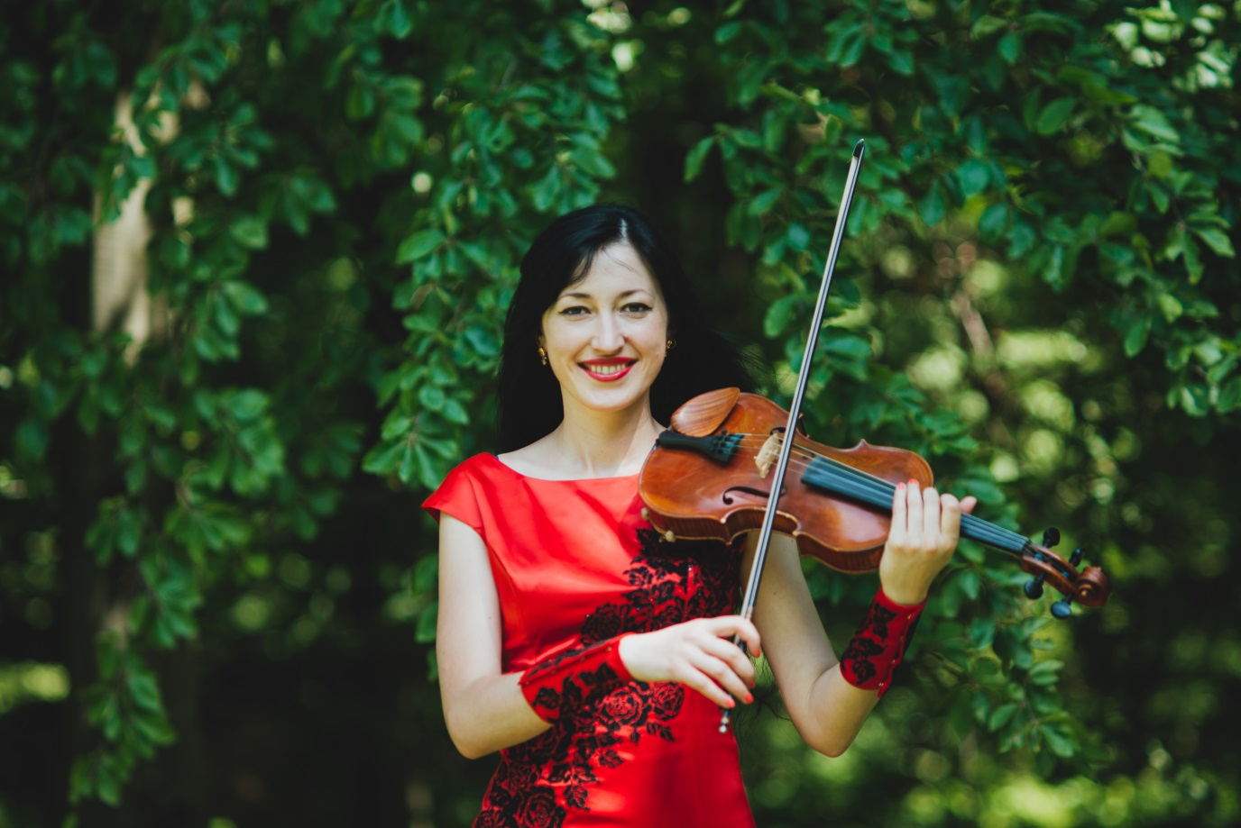
Irina Yatsuschak
Assistant trainee violin, winner of the Grand Prix International festival-contest of young performers "Crimean Spring" (Yalta).
https://www.youtube.com/watch?v=R_KvI2tzoyw

Slide 11
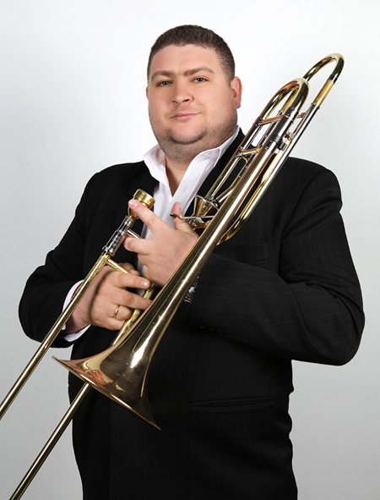
Hook Sergey
While studied in Lviv State Music School, participated in the 1st national competition open to brass instruments, where he became the laureate of third prize.
While studying at the National University of Carpathian, took part in the international competition of brass instruments named after C. Hannha (diploma).
International Competition. Starchenko V. m. Exactly, winner ensemble category (trom Quartet)
Worked in 2010 in the city. Dresden (Germany) Big Band - Boom-Roland.
In 2011 worked in a circus big band eurovision Magical Circus Snoy (Switzerland Geneva)
From 2012 to 2013. Worked in Big Bend National Circus Finland.
Runs in 1st music shkool named after Lysenko, issued winner of the 1st prize Ukrainian Competition. M. Barvinsky on wind and percussion instruments.
Powered solo instrumentalists Symphony Orchestra of Ivano-Frnakivsk Regional Philharmonic Society (concert Meister group trombones).
https://www.youtube.com/watch?v=BmV2ga1tTTQ

Slide 12
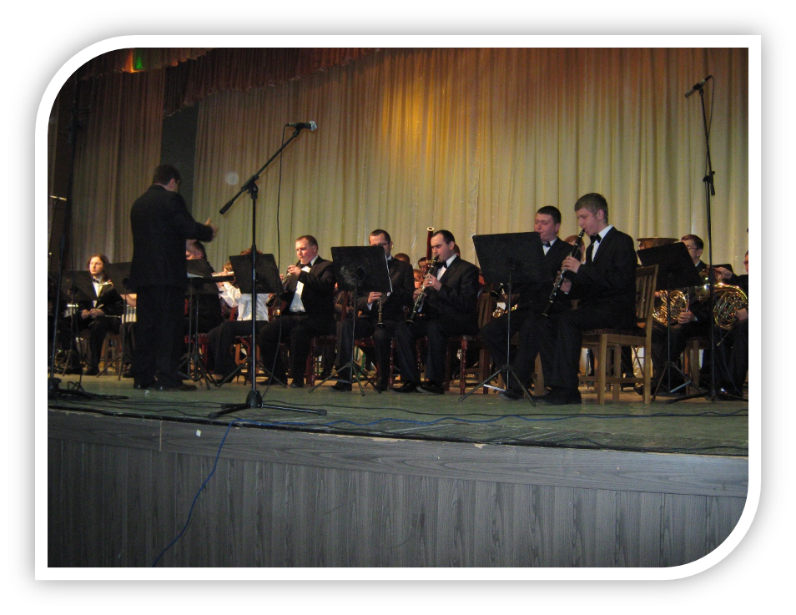
Stepan Yednak
He graduated from the Military Institute, he served in positions of officers in the Armed Forces of Ukraine.
Since 2005. Works in University named after V. Stefanik.
Developed and reads the following courses: orchestral conducting, analyzing and reading orchestral scores, orchestral class.
In 2009 year published handbook “Selected works for concert band”.
In 2011 year publisher handbook “Stanislavsky partitury”
Currently there is artistic director of the Ivano-Frankivsk Municipal Brass band music.
Is a leading author of musical TV "Try to live" on the regional TV channel "Galicia“
Founder of the site “Ukrainian Scores” partytura.com.ua
https://www.youtube.com/watch?v=yz5a_N5grR4
https://www.youtube.com/watch?v=yz5a_N5grR4
https://www.youtube.com/watch?v=uUPjkFHdNRI
https://www.youtube.com/watch?v=NQS9sLsZ_6w
https://www.youtube.com/watch?v=7uW1_xB1VZE

Slide 13
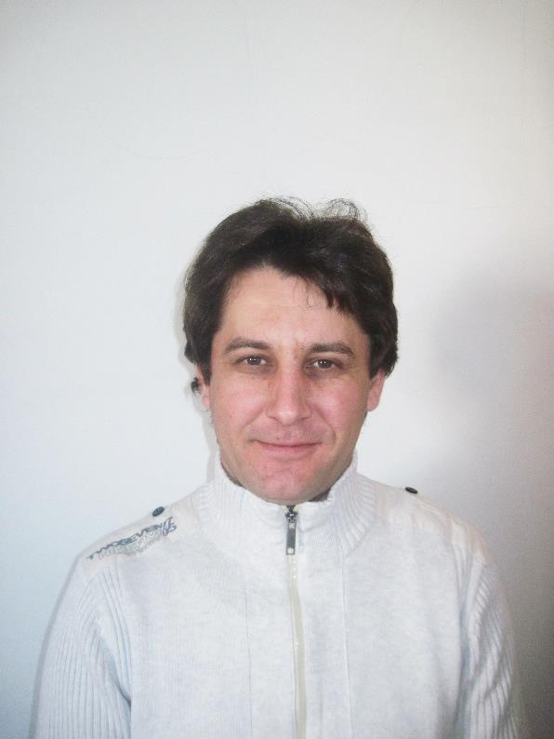
Bohdan Tkachuk
Graduated from Lviv State Music Academy Lysenko specialty "Art of Music" and the qualification of the teacher and orchestral percussion orchestra and additional major military orchestra conductor. Winner of the International Festival Competition "Young Virtuoso".Since 2004, working part-time at the Institute of Arts Carpathian National University named after V. Stefanik. In 2009 he became the author of "Try to live", which successfully implemented the TV "Galicia" of Ivano-Frankshvsk area. Since 2000, successfully traveled solo concerts in Poland, worked in musical groups from Germany, Austria and Switzerland. Since 2004, the orchestra director of the World Festival of Circus Arts.Winner of the International Festival Competition "Young Virtuoso".From 2000 he worked in the orchestra in Switzerland, then - director circus orchestra of the "Magic Show" National Contest (city Geneva).Since 2006, worked the artist of orchestra in the Ivano-Frankivsk Regional Academic Music and Drama Theater named after Ivan Franko and lecturer at the Institute of Art SHEE "Carpathian National University named after V.Stefanik.“
https://www.youtube.com/watch?v=CzPJ_sXISbg
https://www.youtube.com/watch?v=G3og6dFc9KQ

Slide 14
Contacts
Ukraine, m. Ivano-Frankivsk, street of Academician Sakharov 34
The Department of Performing Arts
ktivm@pu.if.ua

