Slide 1
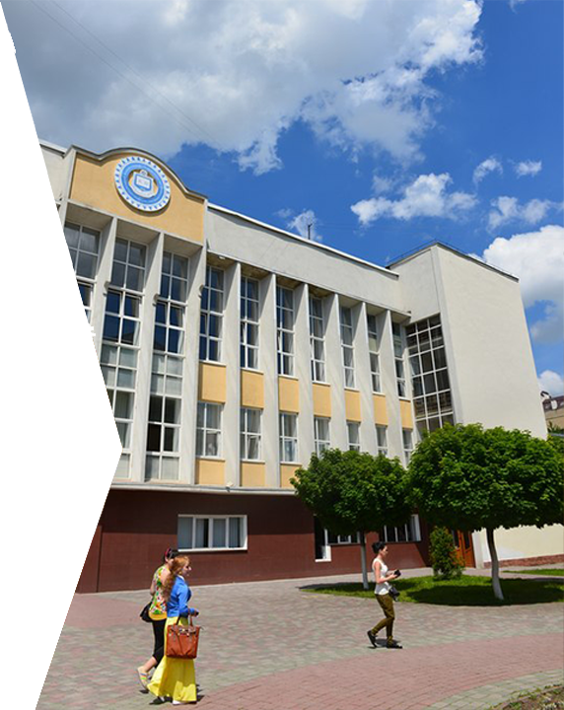

VASYL STEFANYK
PRECARPATHIAN NATIONAL UNIVERSITY
Notes:
1

Slide 2

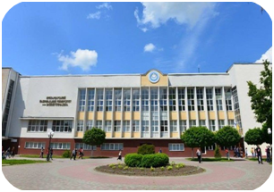
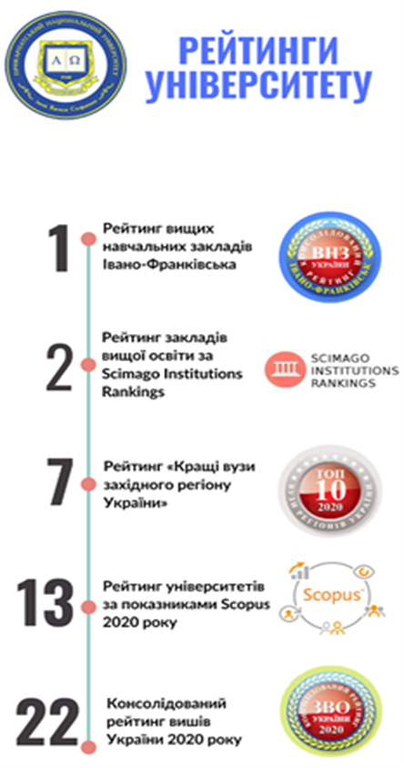
VASYL STEFANYK PRECARPATHIAN NATIONAL UNIVERSITY
Year of foundation - 1940
Vasyl Stefanyk Precarpathian National University is a modern competitive educational and research center of international level, it’s potential influences the development of the region and the formation of human capital
 | persons
the number of scientific and pedagogical staff | 951
number of doctors of sciences | 174
number of candidates of sciences | 587
the number of young scientists | 406
number of students | 14105

Slide 3

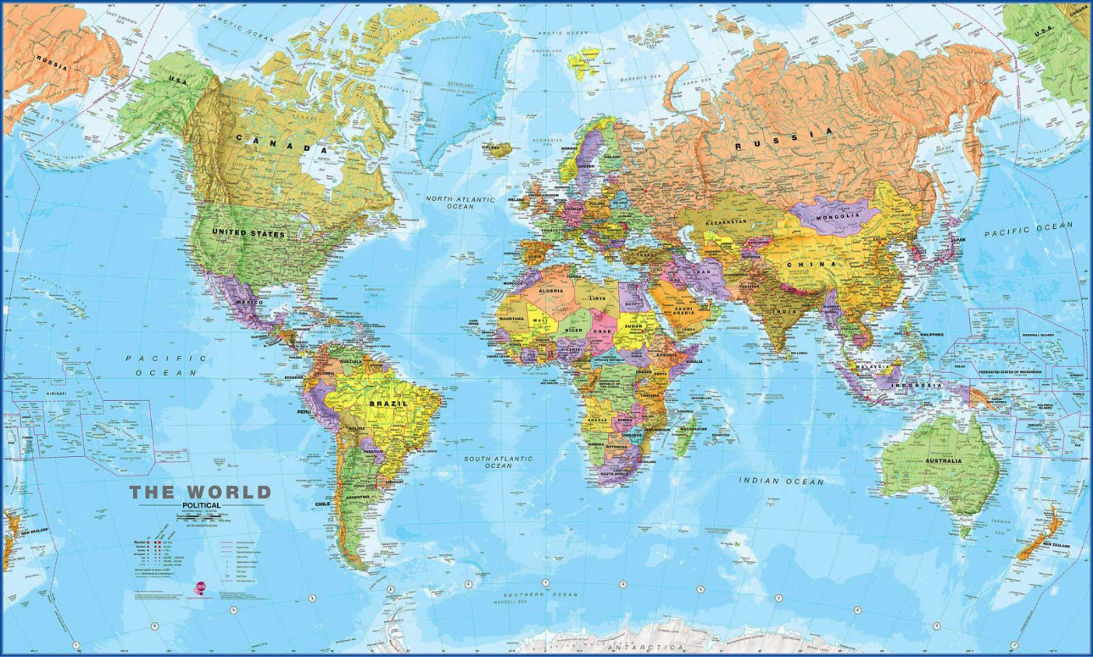

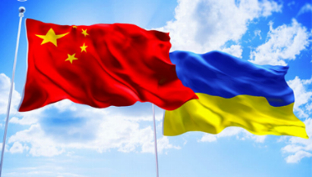

STATE HIGHER EDUCATIONAL INSTITUTION
VASYL STEFANYK PRECARPATHIAN NATIONAL UNIVERSITY
60 universities and organizations from Europe
Our University is a member of international consortia
a member of the European Association of Universities
a member of the consortium of Warsaw and Ukrainian universities
a member of international consortium of universities
a member of a consortium of universities in the Baltic region and Ukraine
a member of the international university community "One Belt - One Way"
a Member of the Magna Charta Universitatum Universities Charter
3 universities and organizations from the USA
5 universities and organizations from China
2 universities from Turkey
Notes:
3

Slide 4

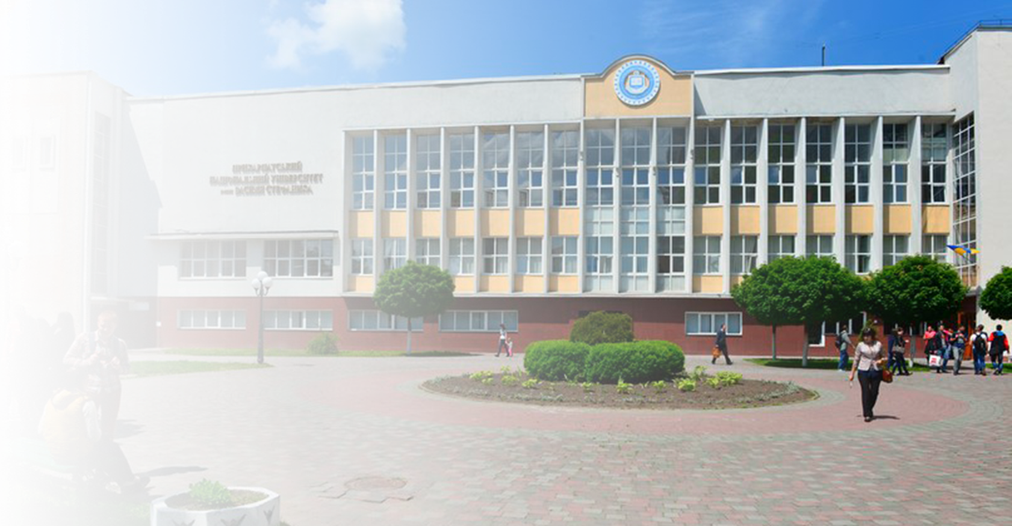
STATE HIGHER EDUCATIONAL INSTITUTION
VASYL STEFANYK PRECARPATHIAN NATIONAL UNIVERSITY
The University has:
4 Educational and Scientific Institutions
11 Faculties
Ivano-Frankivsk College
77 departments, employing 174 Dr.Sci.; 587 Ph.D., associate professors
There are:
14105 full-time and distance learning students, including 4 405– for the state budget
312 postgraduate students, 25 postdoctoral researchers
There are:
there are 10 specialized scientific councils in 17 specialties and 5 doctoral councils in 9 specialties
Notes:
4

Slide 5
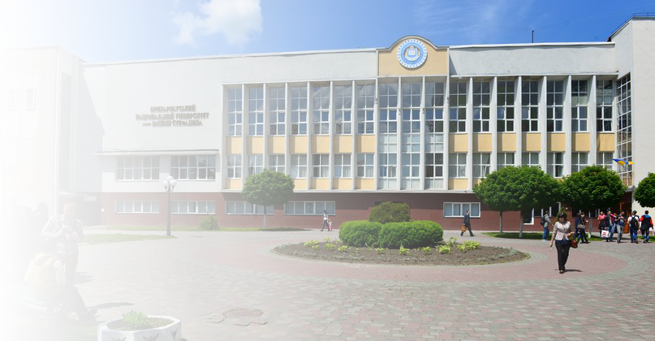
STATE HIGHER EDUCATIONAL INSTITUTION
VASYL STEFANYK PRECARPATHIAN NATIONAL UNIVERSITY
Educational units
- Faculty of History, Political Science and International Relations
- Faculty of Natural Sciences
- Faculty of Tourism
- Faculty of Philology
- Pedagogical Faculty
- Faculty of Philosophy
- Faculty of Economics
- Faculty of Foreign Languages
- Faculty of Mathematics and Informatics
- Faculty of Physical Education and Sports
- Physico-technical Faculty
- Educational and Scientific Institute of Arts
- Educational and Scientific Law Institute
- Kolomyia Educational and Scientific Institute
- Institute of Postgraduate Education and Pre-University Training
- Ivano-Frankivsk College of State Higher Educational Institution “Vasyl Stefanyk Precarpathian National University”

Slide 6


STATE HIGHER EDUCATIONAL INSTITUTION
VASYL STEFANYK PRECARPATHIAN NATIONAL UNIVERSITY
Vasyl Stefanyk Precarpathian National University is one of the first universities that actively implements the double degree diploma programs with the leading European universities
Double degree diploma programs are being implemented
in 12 specialties:
International relations
Law
Informatics
Primary education
Physical Education
History and archeology
Tourism
Physics and astronomy
Mathematics
Philosophy
Politology
Geografy

Slide 7

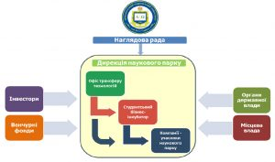
STATE HIGHER EDUCATIONAL INSTITUTION
VASYL STEFANYK PRECARPATHIAN NATIONAL UNIVERSITY
Scientific infrastructure
19 scientific units:
9 scientific laboratories
2 interagency laboratories, incl. Joint Educational and Scientific Laboratory of Magnetic Membrane Physics of H. Kurdiumov Institute of Metal Physics of NAS of Ukraine and Vasyl Stefanyk Precarpathian National University;
International Scientific Center “Observatory”
Center of joint exploitation of scientific equipment “ Center for the Study of Aging and Metabolism Disorders”:
Science Park “Carpathian University”
Botanical Garden
Arboretum "Druzhba"
National Contact Point “Horizon 2020”
Other (Museum, Scientific Library)
The university has 23 educational and research centers
Notes:
7

Slide 8

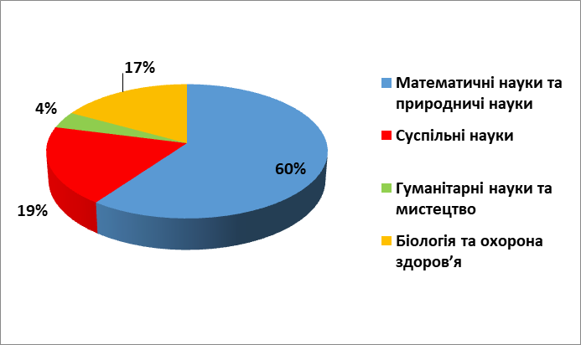
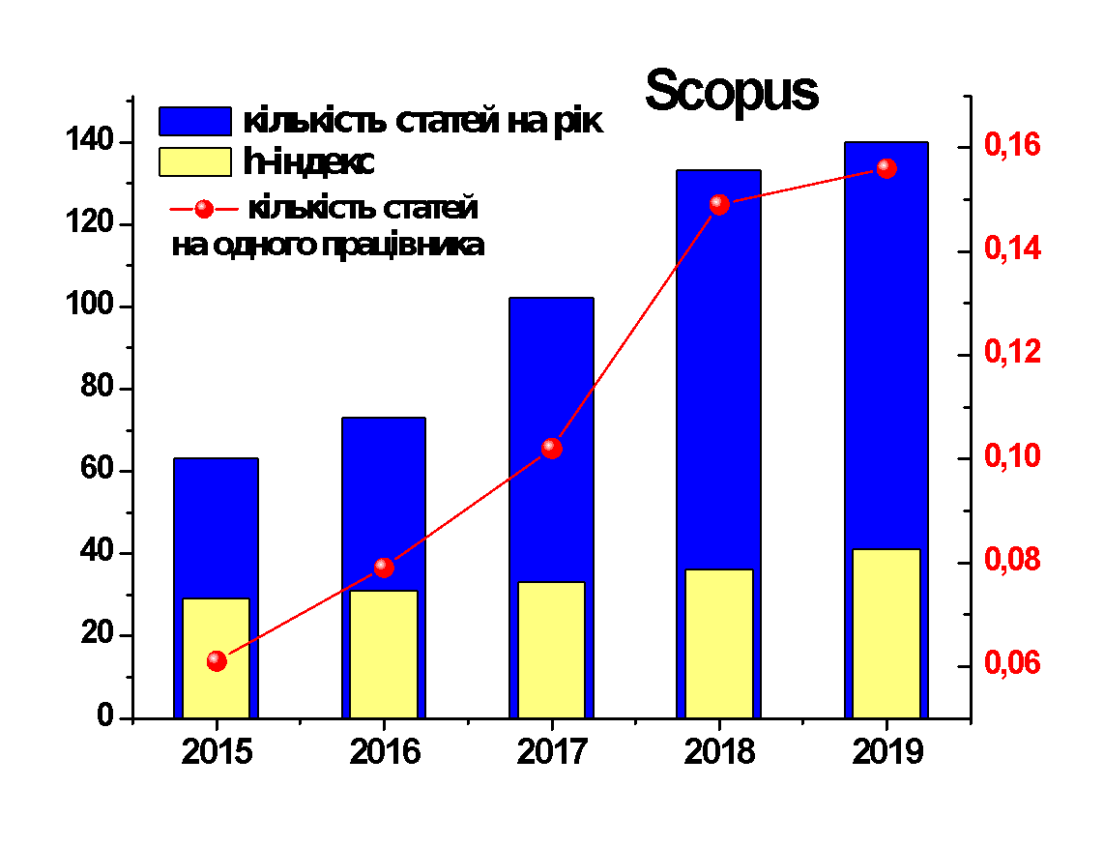
STATE HIGHER EDUCATIONAL INSTITUTION
VASYL STEFANYK PRECARPATHIAN NATIONAL UNIVERSITY
Publishing activity of the University in the SCOPUS indexed editions
- in the ranking of higher educational institutions according of the SCOPUS database the University is on 13th place (2020 )
university h-index = 45
2 university journals are included to the bases of SCOPUS and Web of Science

Slide 9


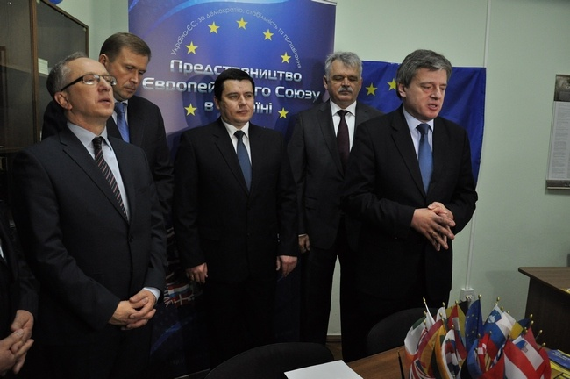
VASYL STEFANYK PRECARPATHIAN
NATIONAL UNIVERSITY
Over the past 7 years, various projects have been implemented at the university for a total amount of $ 3,945,958.7 USA
In 2019, 5 new international scientific projects of various foundations were won
Notes:
9

Slide 10

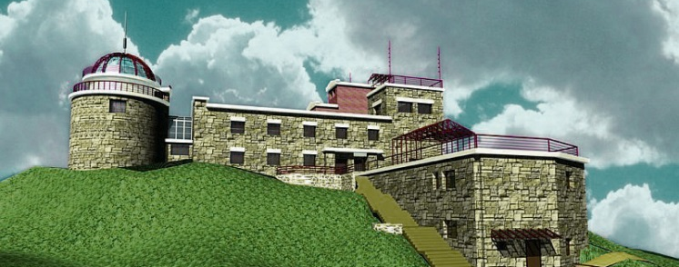
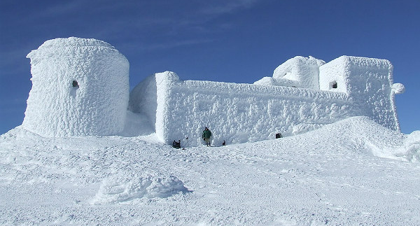

STATE HIGHER EDUCATIONAL INSTITUTION
VASYL STEFANYK PRECARPATHIAN NATIONAL UNIVERSITY
The most promising projects of the university
The most prestigious international scientific projects are being implemented on the basis of the Vasyl Stefanyk Precarpathian National University - the International Scientific Center “Observatory” on Mount Pip Ivan (2027 m).
The project "Adaptation of the former Pip Ivan Mountains Observatory to the needs of the High Altitude Rescue Training Center" is currently being implemented under the Poland-Belarus-Ukraine Cross-Border Cooperation Program 2014-2020 for the amount of € 1,053,000
Notes:
10

Slide 11

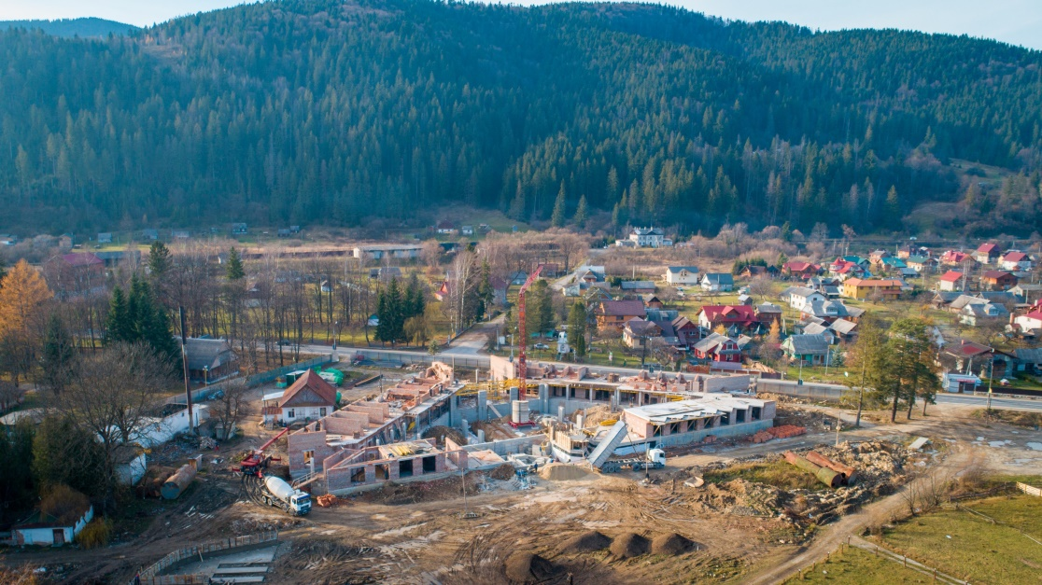
STATE HIGHER EDUCATIONAL INSTITUTION
VASYL STEFANYK PRECARPATHIAN NATIONAL UNIVERSITY
The most promising projects of the university
State Investment Project “Construction of the International Student Youth Meetings Center of Ukraine and the Republic of Poland” is being implemented during 2018-2021
(Mykulychyn village, Ivano-Frankivsk region).
The International Student Youth Meeting Center will be a platform for the development of international youth science activities, IT hubs, student start-ups.
Total cost of the project: 193 342 174,00 UAH.

Slide 12
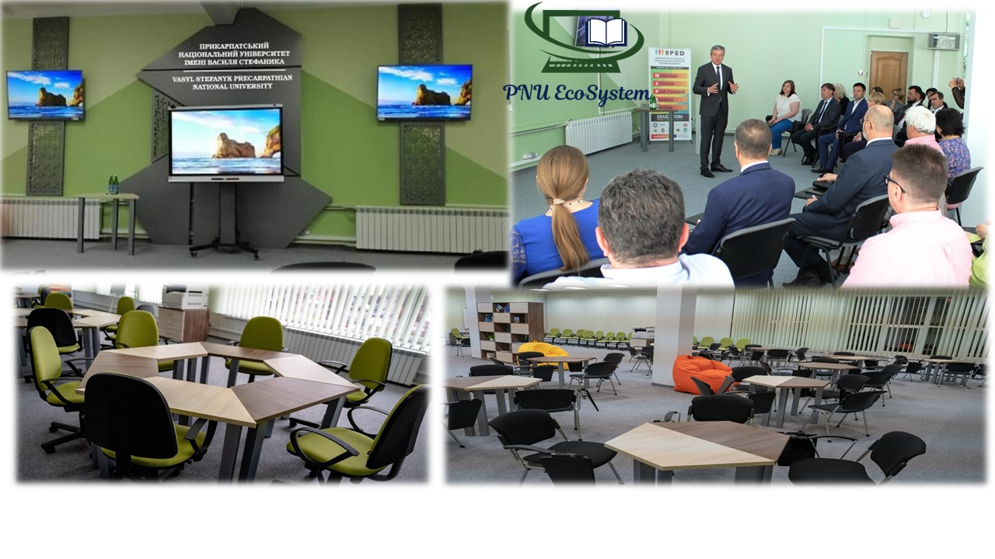

STATE HIGHER EDUCATIONAL INSTITUTION
VASYL STEFANYK PRECARPATHIAN NATIONAL UNIVERSITY
The most promising projects of the university
As a result of the project, the Center for Innovative Educational Technologies «PNU-EcoSystem» was created
During 2018-2021, the project "Modernization of Teacher Higher Education with the Use of Innovative Teaching Instruments" (MoPED) is being implemented within the ERASMUS + KA 2 program, where our university for the first time in Ukraine has become a grant holder in the ERASMUS + KA 2 project.
Total cost of the project: 755 873,0 euro

Slide 13
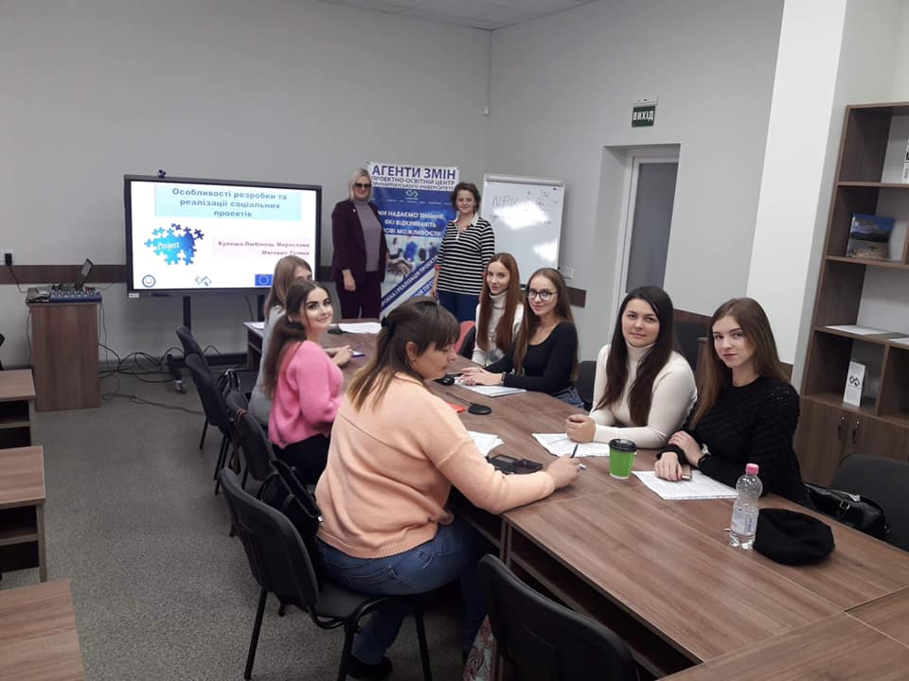

STATE HIGHER EDUCATIONAL INSTITUTION
VASYL STEFANYK PRECARPATHIAN NATIONAL UNIVERSITY
The most promising projects of the university
During the period 2018-2020, the project “Creating of Project and Educational Center for the Development of Innovation and Investment in the Region “Agents of Changes” is being implemented with sector budget support from the European Union.
The total budget of the project is 11 585 409,00 UAH.
Project and Educational Center “Agents of Changes” is a powerful platform for collaboration of our students of different specialties with the representatives of united territorial communities for the preparation and implementation of new projects
In 2019 alone, the Center won 3 grant projects aimed at developing the region.

Slide 14
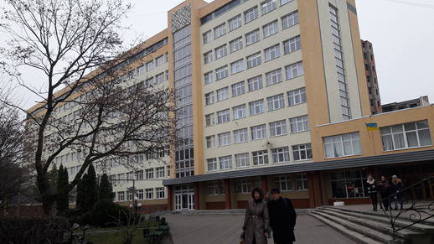
STATE HIGHER EDUCATIONAL INSTITUTION
VASYL STEFANYK PRECARPATHIAN NATIONAL UNIVERSITY
Energy efficiency and infrastructure development projects
During the last 5 years, several major energy efficiency infrastructure projects have been implemented at the University:
insulation, replacement of windows of 8-storey building - 12 000,00 UAH.
reconstruction and overhaul of the hostel № 2 - 16 198,47 UAH.
reconstruction of the heat supply system in the Shevchenko building, 82 - 845,822 UAH.
works on energy saving at the stadium "Science" - 147,42 UAH.
Financing under the Energy Efficiency Component of Phase II of the MES Project jointly with the European Investment Bank and Northern Ecological Finance Corporation “Higher Education of Ukraine”
The total cost of the project is EUR 3088,0.
Reconstruction of: Main educational building No. 1, educational building of the Faculty of Natural Sciences, hostel No. 1, hostel No. 5, auditorium building, building of the assembly hall and library.

Slide 15
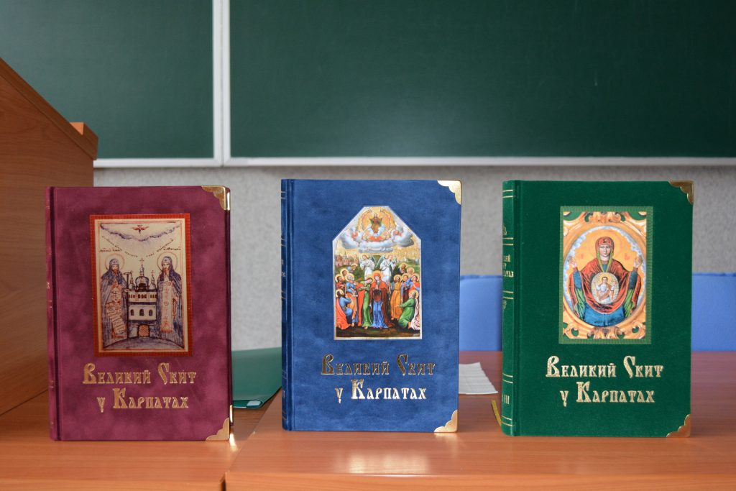
STATE HIGHER EDUCATIONAL INSTITUTION
VASYL STEFANYK PRECARPATHIAN NATIONAL UNIVERSITY
Significant achievements of the University
University scientists published a three-volume scientific publication "Great Scythian in the Carpathians", dedicated to the history and present of the Scythian monastery in Maniava.
The publication reveals the essence of the Scythian spiritual, cultural and historical phenomenon, its importance in the church relations and spiritual life of Ukraine in the context of the events of the 17-18 centuries, the end of the 19 - beginning of the 21 century.
Cost of publication: 130 000 UAH.

Slide 16
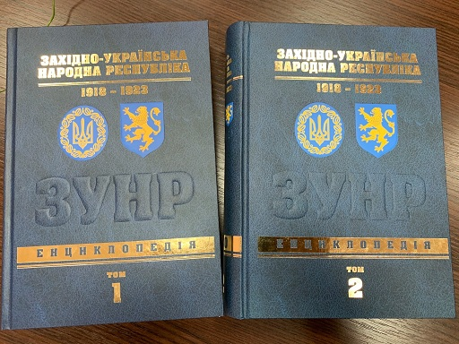
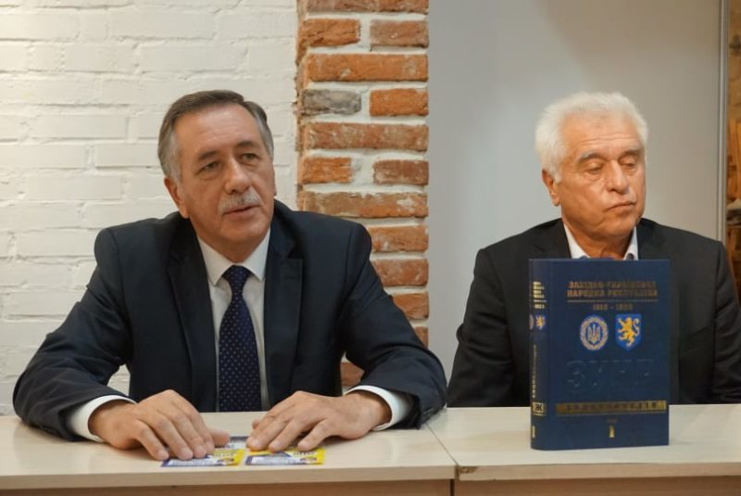
STATE HIGHER EDUCATIONAL INSTITUTION
VASYL STEFANYK PRECARPATHIAN NATIONAL UNIVERSITY
Significant achievements of the University
In 2019, two volumes of the fundamental work of Ukrainian scientists were published “The Western Ukrainian People's Republic 1918-1923. Encyclopedia », incl. with the support of local authorities of Ivano-Frankivsk and Lviv regions.
Cost of publication: 1 700 000 UAH.

Slide 17
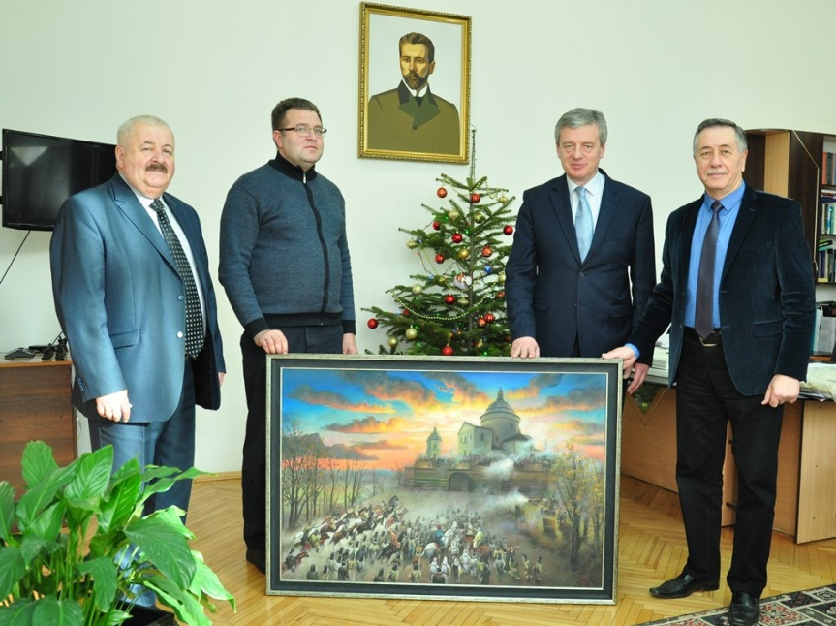

STATE HIGHER EDUCATIONAL INSTITUTION
VASYL STEFANYK PRECARPATHIAN NATIONAL UNIVERSITY
Significant achievements of the University
In 2018, a unique book was released
"The Goshiv Monastery in Written Historical Sources of the 16th - 20th Centuries",
which launches the three-volume edition
«The Monastery of the Holy Mother of God on the Mountain Iasna in the Carpathians»
Its authors are the scientists of the University
Cost of publication: 130 000 UAH
Unique picture "Defense of the Mountain Iasna", which was painted by the students of the University, passed to the Goshiv Monastery

Slide 18

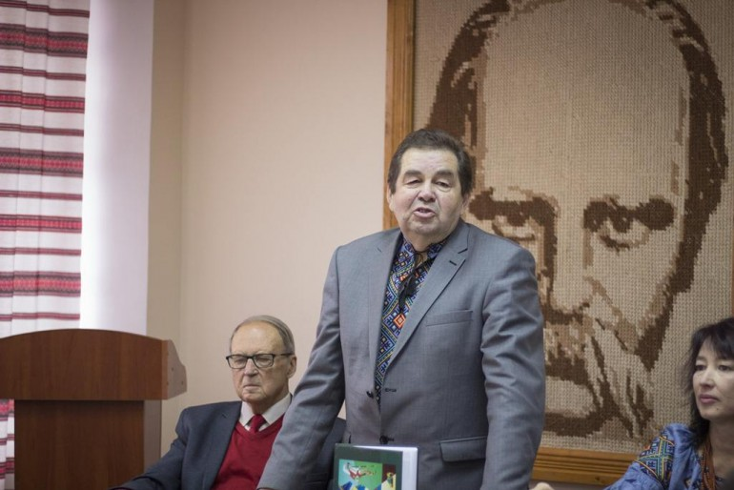
STATE HIGHER EDUCATIONAL INSTITUTION
VASYL STEFANYK PRECARPATHIAN NATIONAL UNIVERSITY
Significant achievements of the University
In the second half of 2019, a unique edition was published - Volume I of the Dictionary "Hutsul Dialect Vocabulary and Phrasemics in Ukrainian Art Language"

Slide 19

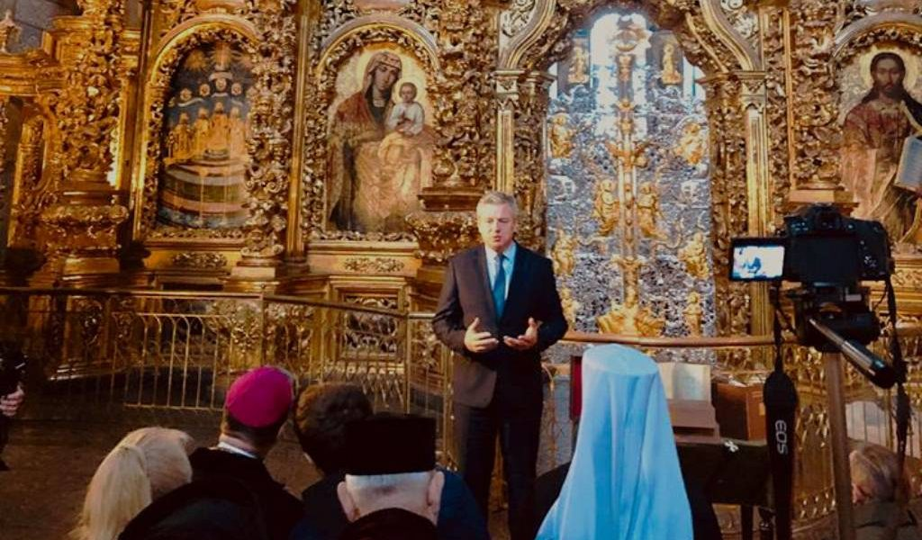
STATE HIGHER EDUCATIONAL INSTITUTION
VASYL STEFANYK PRECARPATHIAN NATIONAL UNIVERSITY
Significant achievements of the University
Facsimile edition of the Galician Gospel - a joint project of the Church, the Precarpathian National University and the Ukrainian Catholic University

Slide 20
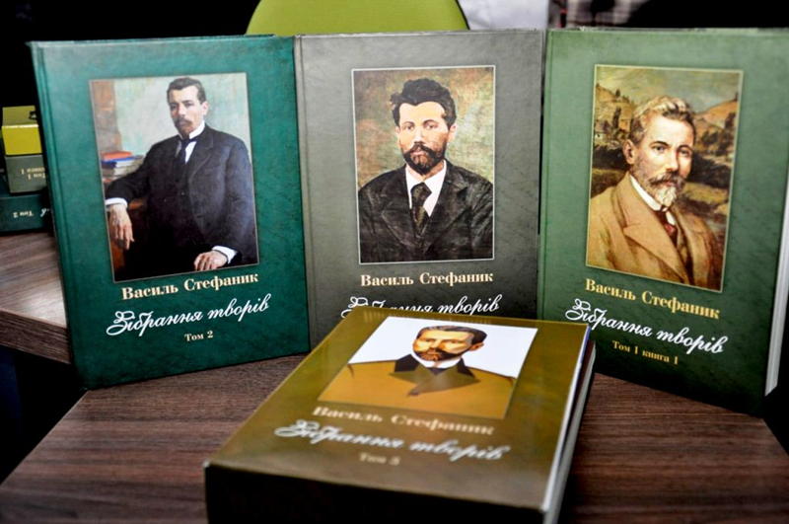
STATE HIGHER EDUCATIONAL INSTITUTION
VASYL STEFANYK PRECARPATHIAN NATIONAL UNIVERSITY
Significant achievements of the University
To mark the 150th anniversary of Vasyl Stefanyk's birth, university scientists have prepared a unique four-volume edition - "Collection of Vasyl Stefanyk's Works"
The project was supported by the Ivano-Frankivsk Regional Council with funding of UAH 500,000.

Slide 21
ПРИКАРПАТСЬКИЙ НАЦІОНАЛЬНИЙ
УНІВЕРСИТЕТ ІМЕНІ ВАСИЛЯ СТЕФАНИКА
Significant achievements of the University
Two scientists of the Precarpathian University - Professor Volodymyr Lushchak and Associate Professor Tetyana Tatarchuk entered the TOP-2% of scientists in the world according to the results of the prestigious rating.
A total of 85 scientists from all over Ukraine were included in the ranking and their list is headed by Professor Volodymyr Lushchak.

Slide 22
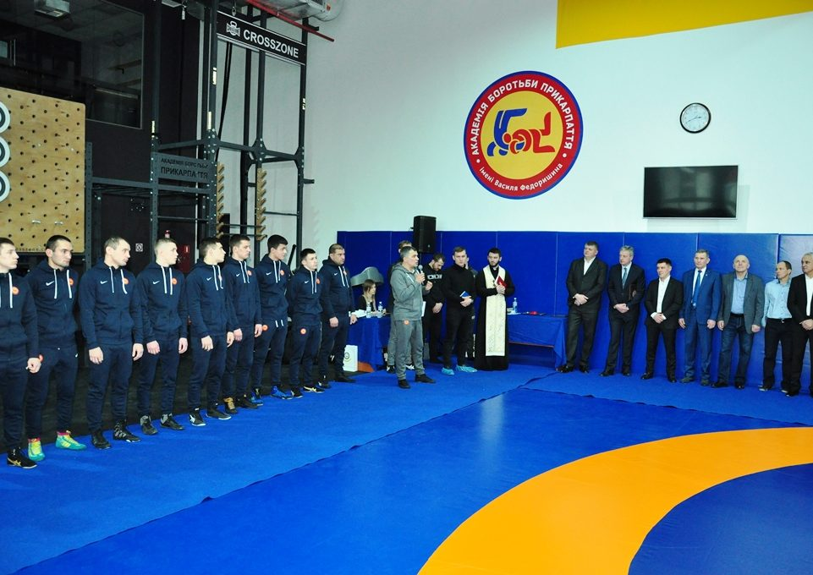
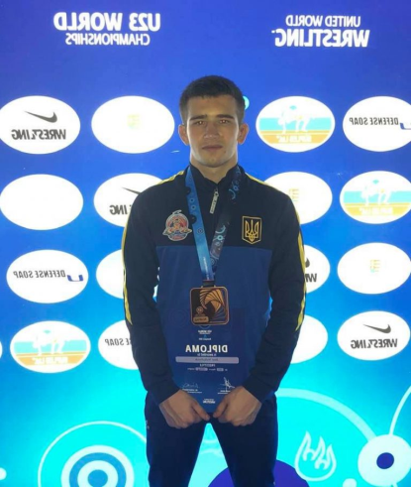
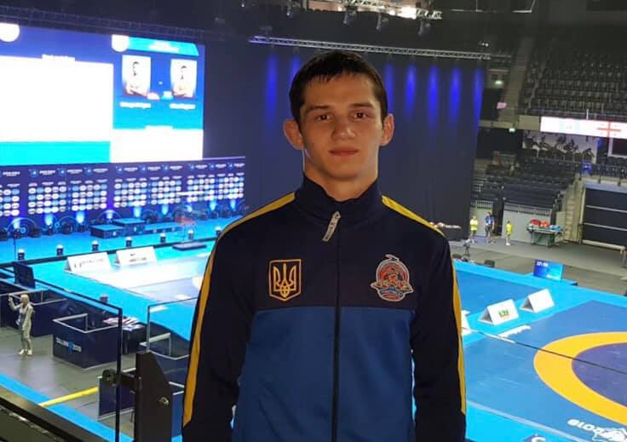
STATE HIGHER EDUCATIONAL INSTITUTION
VASYL STEFANYK PRECARPATHIAN NATIONAL UNIVERSITY
Sports achievements of the University
Our pride
Andriy Dzhelep (silver medalist of the Under-23 World Championships and free wrestling) (3rd year student)
Igor Nykyforuk (bronze medalist of the World Championship among 23-year-old freestyle wrestlers) (3rd year student)
In 2020, the only free wrestling academy in Ukraine was opened at the university.
The established Academy has as its mission to bring talented sports youth of the Western region to the world level of sports achievements.

Slide 23
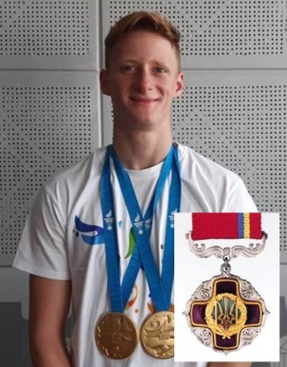
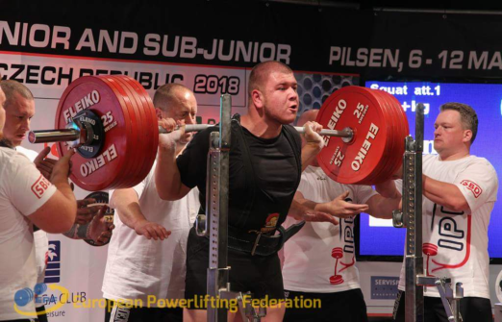

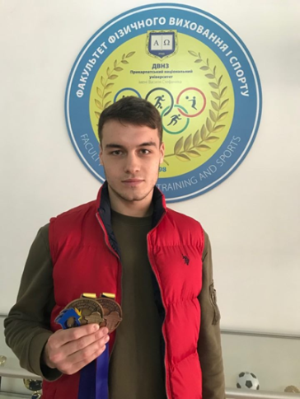
STATE HIGHER EDUCATIONAL INSTITUTION
VASYL STEFANYK PRECARPATHIAN NATIONAL UNIVERSITY
Sports achievements of the University
Mykhailo Senyk - Honored Master of Sports of Ukraine, the national team of Ukraine in Athletics, holder of the Order "For Merit" of third degree - two gold medals for the second European game in Minsk (2019).
Victor Holinei - Powerlifting Master of Sports of international class- Powerlifting World Champion (Regina, Canada, 2019).
Viktor Poliakov - WBA Intercontinental Boxing Champion, Member of the 2004 Olympic Games
Danylo Demchyshyn - International Kickboxing Master of Sports, European Taekwondo ITF Championships, Sarajevo (Bosnia and Herzegovina), 2019 - gold medal, ITF World Taekwondo Champion, Izzel (Germany), 2019 - gold medal.

Slide 24


STATE HIGHER EDUCATIONAL INSTITUTION
VASYL STEFANYK PRECARPATHIAN NATIONAL UNIVERSITY
Sports achievements of the University
Women's Basketball Team “Frankivsk PNU” won the European 3x3 Basketball Championship (Split, Croatia) and finished second in the European Student Games (Coimbra, Portugal) and fifth in the World’s Championship
In total, the students of the University for 2019 were awarded
9 gold, 8 silver and 9 bronze medals at various competitions of all-Ukrainian level,
as well as 3 gold, 3 silver and one bronze medals at European and world level competitions

Slide 25
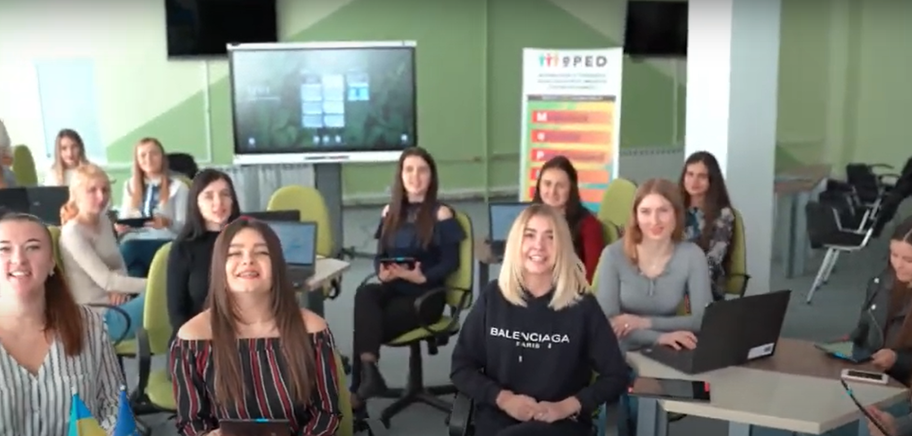
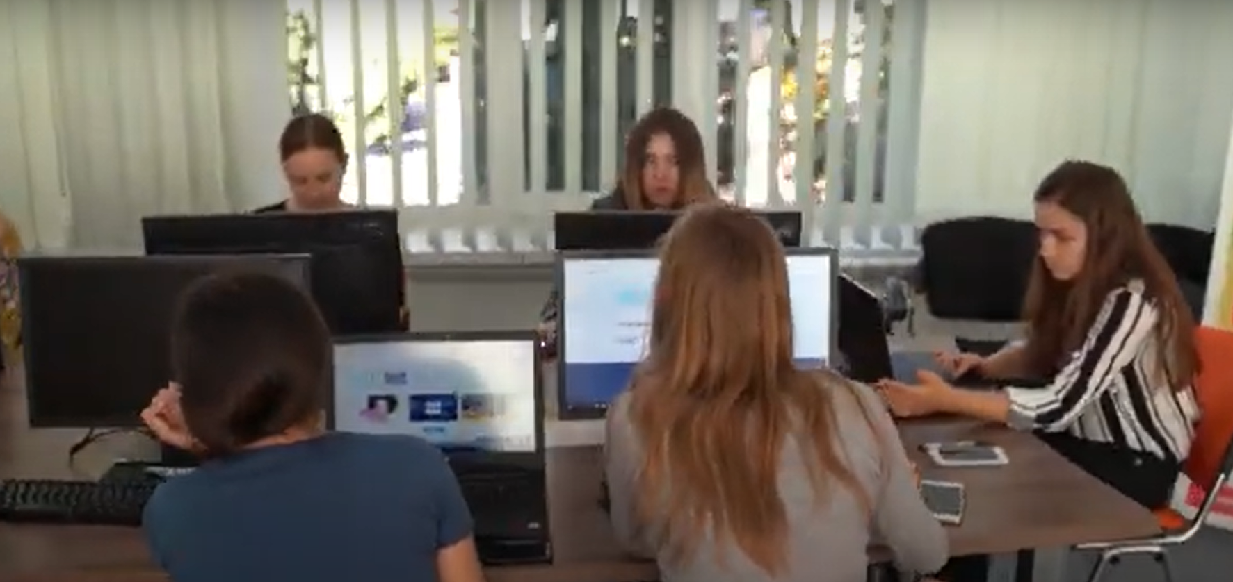
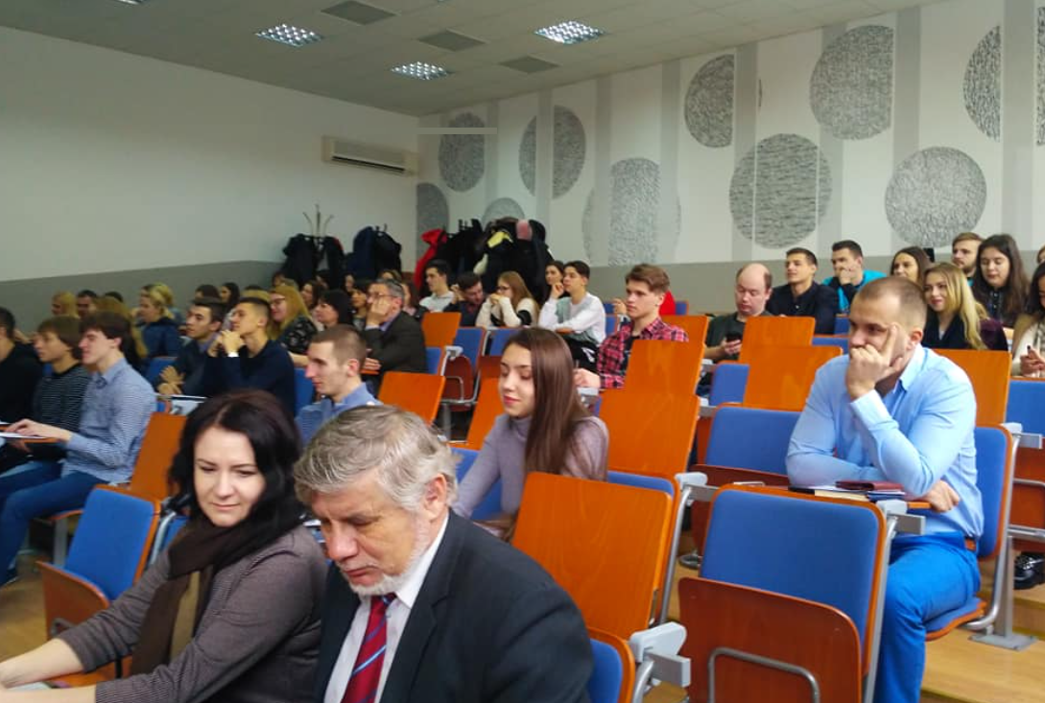
STATE HIGHER EDUCATIONAL INSTITUTION
VASYL STEFANYK PRECARPATHIAN NATIONAL UNIVERSITY
University weekdays
The university has created the best conditions for students to study using innovative technologies

Slide 26
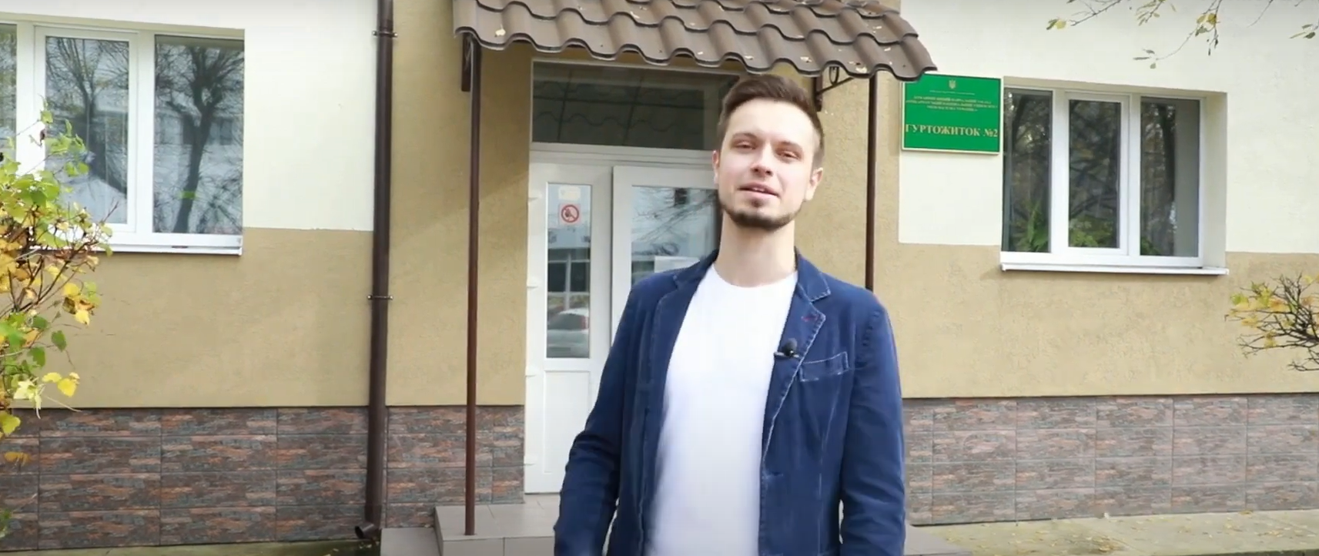
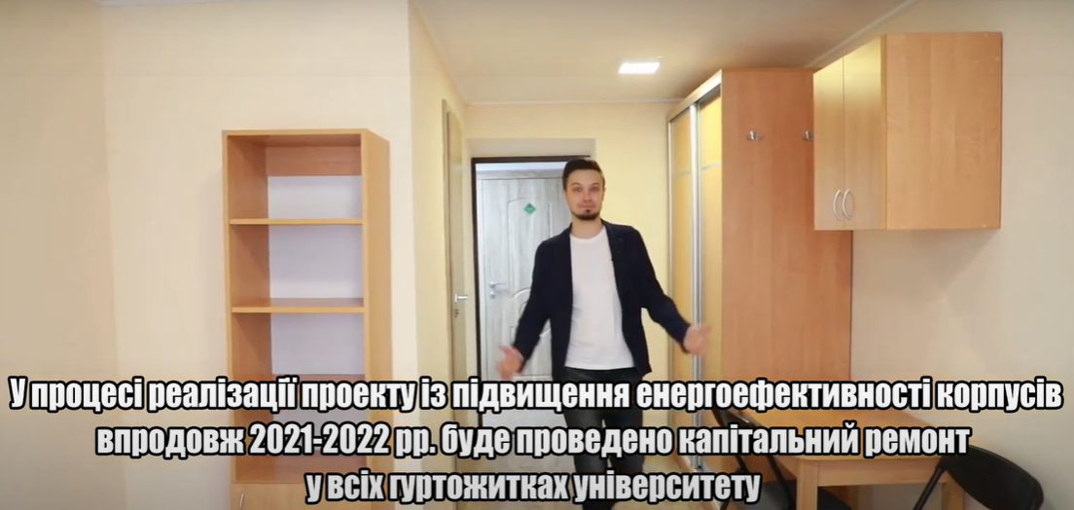
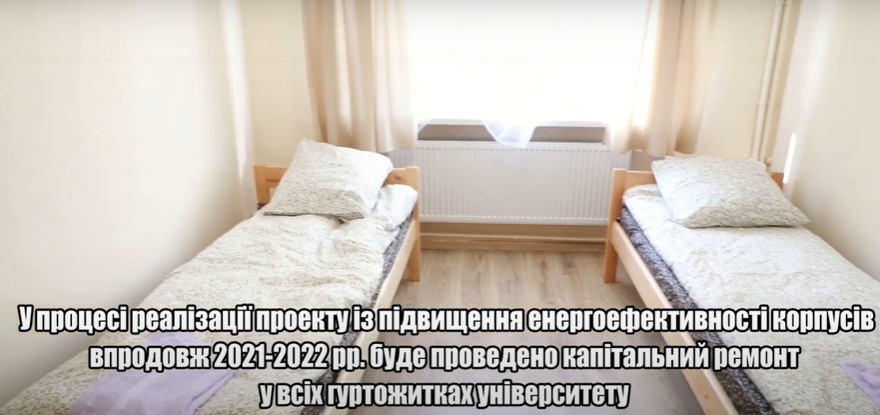
STATE HIGHER EDUCATIONAL INSTITUTION
VASYL STEFANYK PRECARPATHIAN NATIONAL UNIVERSITY
University weekdays
The university has created the best conditions for students to live in dormitories

Slide 27
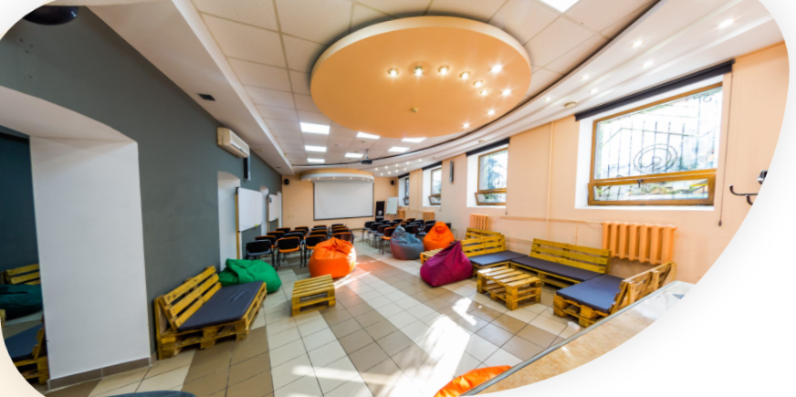
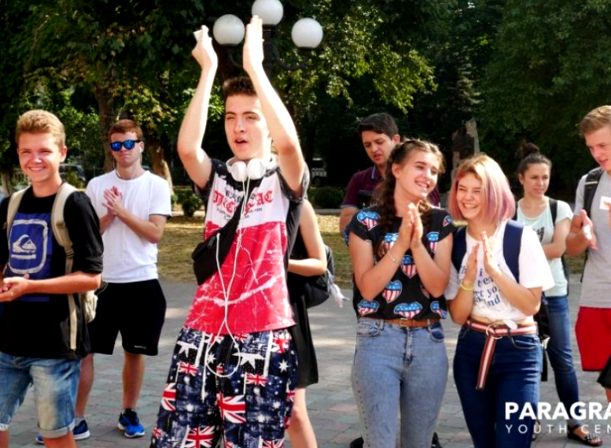
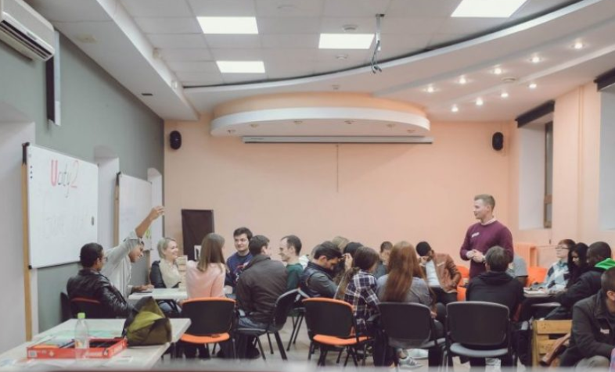
STATE HIGHER EDUCATIONAL INSTITUTION
VASYL STEFANYK PRECARPATHIAN NATIONAL UNIVERSITY
University weekdays
The university has a coworking student center "Paragraph"

Slide 28
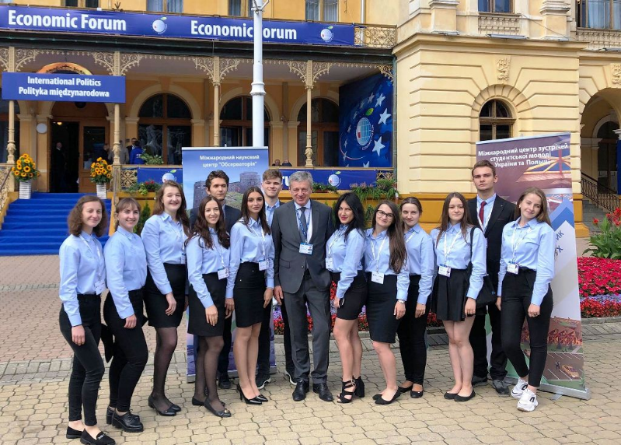
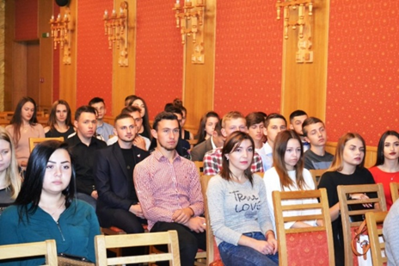
STATE HIGHER EDUCATIONAL INSTITUTION
VASYL STEFANYK PRECARPATHIAN NATIONAL UNIVERSITY
Unique opportunities for students
Scholarship opportunities for students:
State scholarships
Non-state scholarships:
1) scholarships of the Believe in Yourself Foundation: 25 scholarships (2000 UAH / month) + 2 projects (100 000 UAH)
2) scholarships of East European Research Institute Fund: 15 scholarships ($1,000) + 3 awards ($ 1,000) for best master's theses
3) Lozinski Foundation (USA) scholarships: 10 scholarships ($ 500)
International professional training of students:
in Germany: 3-10 months training in different specialties in 2 companies;
Poland 3-4 day monthly training on different specialties in different companies;
in 6 EU countries under ERASMUS + KA 1 programs: projects won with 11 universities

Slide 29


Welcome to
VASYL STEFANYK
PRECARPATHIAN NATIONAL UNIVERSITY!
http://pnu.edu.ua/
e-mail: office@pnu.edu.ua

