Slide 1

US Market at a glance & Main challenges and opportunities in the US market
Ildikó Dorogi
International Expert
Regional Centre for Information and Scientific Development, www.rcisd.eu

Slide 2

I. General Points
General Points
9,826,675 sq km, 2 ½ times the size of Western Europe
Most technology powerful country in the world
325 million population (2016)
GDP of $18.56 trillion (2016)
GDP per capita (purchasing power) of about $57,300 (2016)
Unemployment Rate – 4.1% (Sept, 2017)
Sources: U.S. Census Bureau 2015; World Fact Book, CIA, 2016; Bureau of Labor statistics 2017
Notes:
The total land area of the United States is almost 10 million square km, 2 and half times bigger than Western Europe
Most technology powerful country in the world
The polulation of the US was estimated to be 325 million in 2016
In 2016 GDP in the US was almost $19 trillion
GDP per capita is about $57,300
Unemployment rate decreases

Slide 3

II. Population Trends
Population Concentrations
Notes:
Dark blue areas are the highest concentrations of the population. (yellow and light green areas have low concentrations of the population)
Today there area high concentrations along the East and West coastal regions with concentrations around major metropolitan areas such as
- San Francisco, Los Angeles in West Coast
- Huston, Dallas in South
- Chicago, Detroit, New York, Washington in East Coast
For SMEs normally any of the dark blue areas would be a significant market.

Slide 4
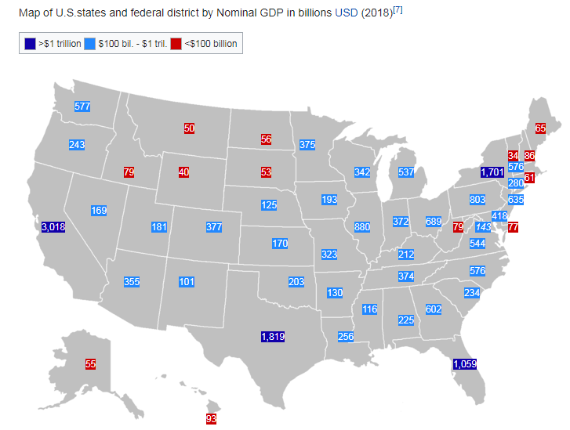
III. Gross Domestic Product Trends
Notes:
California, Texas, New York than Florida have the largest GDP in the USA

Slide 5
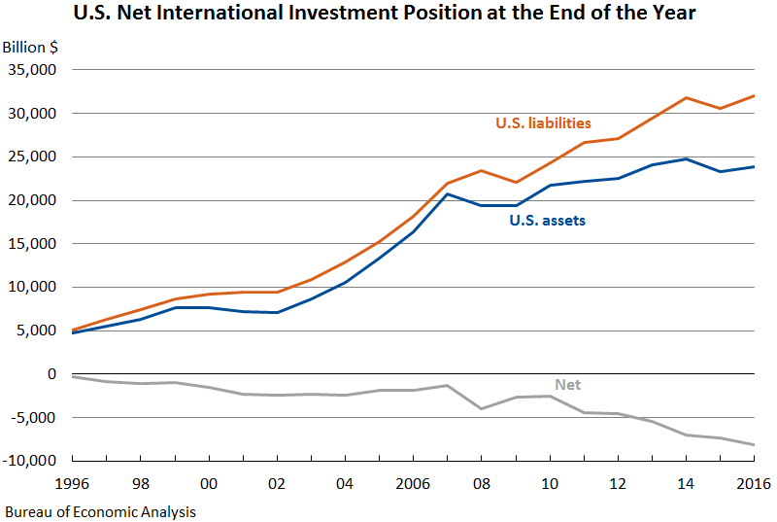
IV. How Healthy is the Market
Investment
Foreign Direct Investment (billions USD, 2015)
Europe (2,162)
UK (484)
Asia and Pacific (564)
Canada (269)
Latin America (119)
Source: Direct Investment Positions for 2015: Detailed Historical-Cost Foreign Positions in the United States
Source: Bureau of Economic Analysis – US Department of Commerce
Notes:
The United States is the largest of global FDI, its inward FDI stock is $2.9 trillion in 2014.
The USA is still an attractive market for foreign direct investment.

Slide 6

IV. How Healthy is the Market
Manufacturing Industry
Undergoing a “reshoring” trend
37% of executives with $1 billion or more in sales are bringing, or considering to bring, their production to the US from China (2012).
Brought back manufacturing: General Electric, Nissan and Ford.
2015 resulted in about 300 reshoring cases with electronics and transportation equipment companies leading the way, followed by high-end apparel. A drop in the bucket!
Benefits of US:
Less risky investment climate
Stability in wage inflation
Enhanced productivity
Availability of skilled labor (consistent quality)
Notes:
In the US there is a reshoring trend but not as significant as expected in 2012, when 37% of executives with $1 billion or more in sales are bringing their production to the US from China
Reshoring is the act of bringing manufacturing and services back to the location from which they were originally outsourced, back to the U.S. from overseas.
As of 2016, reshoring has been a “drop in the bucket” (it was not as sufficient as expected) compared to many years of “offshoring” trends.
Manufacturers bringing back the most jobs:
Walmart (China to US)
Ford (Mexico to US)
Boeing (worldwide to US)
General Electric (China, Mexico to US)
General Motors (Mexico, Canada to US)
Caterpillar (Japan, Mexico to US)

Slide 7

IV. How Healthy is the Market
Technology & Innovation
Technology:
US ranking with regard to high-technology manufacturing industries (2014):
Aerospace – 1st
Scientific Instruments* – 1st
Pharmaceuticals – tied with EU
Information and Communication Technology – behind China
Overall value added of high technology manufacturing industries from 1998-2010 – US 1st above EU and China (2nd & 3rd)
*Scientific Instruments: testing, measuring and control instruments
Source: US National Science Board’s Science and Engineering Indicators 2016
Notes:
Certainly the gap that existed in 2010 between the US and China/EU has decreased,
as China continues to get stronger in its high technology manufacturing capabilities.

Slide 8
Main Takeaways!
Due to its size, in most cases the US market should be approached from a regional market perspective.
The population migration trends should be considered when identifying consumer product opportunities in regional markets.
GDP fluctuations provide important indications of growing or shrinking regional markets.
The US is still a leading player in Technology Innovation creating new opportunities for EU companies.
The US manufacturing sector still provides opportunities for EU companies.

Slide 9
Main challenges and opportunities in the US market
I.
Challenges & Opportunities
II.
Consumer Products Perspective
9

Slide 10
I. Challenges & Opportunities
Main Challenges
Size of the Market – Normally need to identify target regional markets
Geographical Distance From the Market – Adds supply chain costs
Time Zone Differences – 5 to 10 hour difference depending on the regions involved
Exchange Rate Fluctuations – Euro to Dollar in the last 12 months: + 8%; last 5 years: +16%
Local Laws and Regulations - Challenges with regulations, testing, and standards
Strong Competition – Saturated market (products and services)
Complex Tax System – Taxes on services and products can be imposed by both the US federal government and individual states, counties and cities
Sources: U.S. Census Bureau 2015; World Fact Book, CIA, 2016; Bureau of Labor statistics 2017
Notes:
SMEs are interested in entering the US market face the following challanges:
- US has the largest market in the world, therefore, EU companies need to target specific regional markets.
- Geographical distance adds logistics costs
- Exchange Rate Fluctuations: The Dollar- Euro exchange rate is highly volatile
- In the US, some state laws and regulations are enacted which are stricter than the federal laws. In the EU, European laws are harmonized at the same level for all member states.
Strong competition leads to a saturated market since there are several competitors. For example the US market is oversaturated with retail space
Complex Tay System

Slide 11
I. Challenges & Opportunities
Main Opportunities
Large Single Market - Largest consumer market with a GDP of $18 trillion and 325 million people
One Common Language – Although Spanish can be important in specific regional markets
Common General Culture – Common spending trends by demographic
Economically and Politically Stable - Ranked among the first 30 countries with the lowest regional political risk in the world
Access to Global Supply Chain - Can lead to doing business with other markets
Low Average Tariffs - EU-US low average tariffs (under 3%)
Notes:
- The US has the largest consumer market on earth with a GDP of $18 trillion and 325 million people.
- Common language, general culture:
- Economically and politically stable: Economic growth in the United States is stable, US is in the first 30 countries with the lowest regional political risk in the world
- Access to global supply chains: Can lead to doing business with other markets
- Low average tariffs: EU-US low average tariffs (under 3%), trade-weighted average import tariff rate on industrial goods is 2%. One-half of all industrial goods entering the United States are duty free.

Slide 12
I. Challenges & Opportunities
Potential Opportunities – Product/service dependent (requiring market analysis)
Technologically Advanced Economy – Business opportunities in new areas
Comprehensive Intellectual Property (IP) Laws - Strong legal enforcement against infringement, offering a high standard of protection for IPR
Product Certification - Certain products can be tested and certified for the US market by private industry organizations
Notes:
- The U.S. economy has highly-developed and technologically-advanced services sector, which accounts for about 80% of its output.
- The US has comprehensive intellectual property (IP) laws, both domestic and international intellectual property protection. It has strong legal enforcement against infringement, offering a high standard of protection for IPR.
- Product certification: Before exporting to the US, EU companies need to make sure that products meet all legal requirements in the US and have all the required licenses. Certain products can be tested and certified for the US market by private industry organizations

Slide 13

II. Consumer Products Perspective
The US is a world leader in consumer products market research, product innovation, manufacturing, and branding and marketing.
In 2015, the U.S. consumer goods market was the largest in the world, estimated at $446 billion
Source: USA.GOV
Notes:
- Economic stability and the impact on consumer behavior are key factors in the consumer goods market.

Slide 14

II. Consumer Products Perspective
The US market is highly saturated in terms of Consumer Products, therefore, product differentiation and product marketing are key factors
Product Differentiation
Segmentation
Certification
Branding/Marketing
Labelling
Product Design
Packaging
Product Quality
Service Quality
Notes:
- EU companies need to adapt changing of consumer behavior and trends
- In the digital world, consumers have big expectations, therefor product differentiation is a key factor
- Finding market niches is one of the most popular strategies to enter the US Market.

Slide 15
II. Consumer Products Perspective
SMEs are essential drivers of innovation and growth and represent a significant share of the US imports
SMEs
SMEs represent a significant segment of the exporting community and of the value of total US imports.
SMEs in many sectors can only supply small regions of the US market.
The level of exporting activity increases with firm size.
Online sales channel is emerging as the key enabler for SMEs exporting to the US.
Regional Market Perspective
Notes:
- SMEs are essential motors of job creation, innovation and growth in Europe and account for an significant share of the EU's exports around the world, including to the United States - the most important destination for all European exports.
- 90% of European and US companies are SMEs – over 20 million companies in the European Union and 28 million in the United States
8% of the EU SMEs in the 33 countries have technological cooperation with enterprises from the U
SMEs in many sectors can only supply small regions of the US market.
The level of exporting activity increases with firm size.
Online sales channel is emerging as the key enabler for SMEs exporting to the US.
So US market should be approached from a regional market perspective.

Slide 16





Various ways to stay informed
Thank you!
Ildikó Dorogi
International Expert
Regional Centre for Information and Scientific Development
www.rcisd.eu
General Enquiries:
usa@enrichcentres.eu | www.usa.enrichcentres.eu

