Slide 1
Support services available
2018 - 2019
ENRICH in Brazil Info-Day
Ivano Frankivsk, 17 October 2019

Slide 2
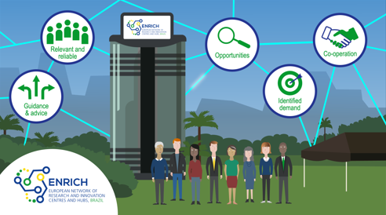
ENRICH services
THE ENRICH EXPERIENCE
The ENRICH centre is the main hub and contact point for European and Brazilian innovation actors interested in bilateral cooperation.
The services provided by ENRICH in Brazil supports users at each stage of their journey. The ENRICH Experience and the services available will contribute to the creation of research and business (R&B) opportunities for Europeans and Brazilians as well.
ENRICH in Brazil offers a comprehensive range of services tailor-made to address the needs of R&I&B organizations

Slide 3




ENRICH SERVICES
STRUCTURED IN FOUR SERVICE CATEGORIES
Notes:
The services of the ENRICH Centre are structured in four categories,…

Slide 4

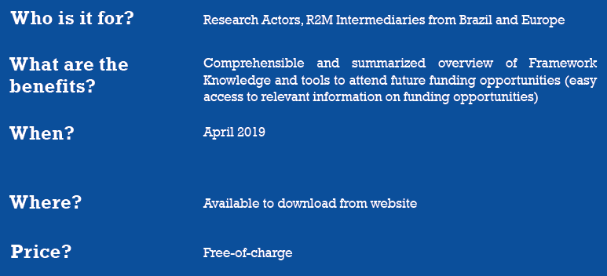
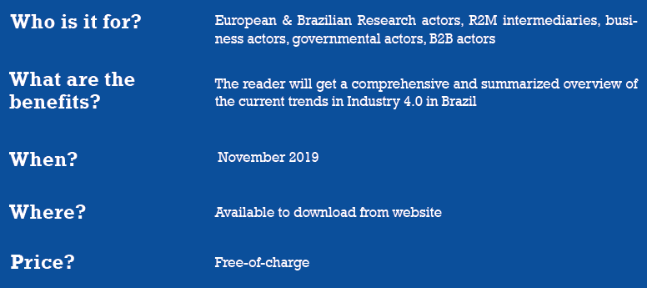
ENRICH services
INFORMATION SERVICE I.
1. Information on Funding Possibilities
GUIDELINES FOR INNOVATION FUNDING POSSIBILITIES IN BRAZIL
GUIDELINES FOR INNOVATION FUNDING POSSIBILITIES IN EUROPE
2. Market & Research Study: Industry 4.0
Notes:
Some examples of the Information Services:
Funding possibilities, - all available free of charge through the ENRICH website
Comprehensive and summarized overview of Framework Knowledge and tools to attend future funding opportunities (easy access to relevant information on funding opportunities
Market study Industry 4.0 - will analyse the digital transformation in Brazil and Europe. The study will be based on a global survey. Provides a comprehensive overview on the current trends in Industry 4.0 in Brazil
Will be published in autumn 2019

Slide 5
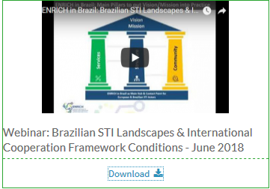


ENRICH services
INFORMATION SERVICE II.
3. Webinar Series:
Showcase the Brazilian Innovation Ecosystem with Focus on the Applied Research Sector
Introduction of ENRICH in Brazil’s Soft Landing Hubs
Sectorial & Thematic Webinars
European Science, Technology & Innovation Landscape in a Nutshell
Past webinars are available for download at:
http://brazil.enrichcentres.eu/presentations-and-training
Further webinars foreseen for June – December 2019
For exact dates, topics and details see our website and follow us on and
http://brazil.enrichcentres.eu
Notes:
Webinar series on Brazilian innovation ecosystem (for Europeans) – and on European STI landscape for Brazilians

Slide 6

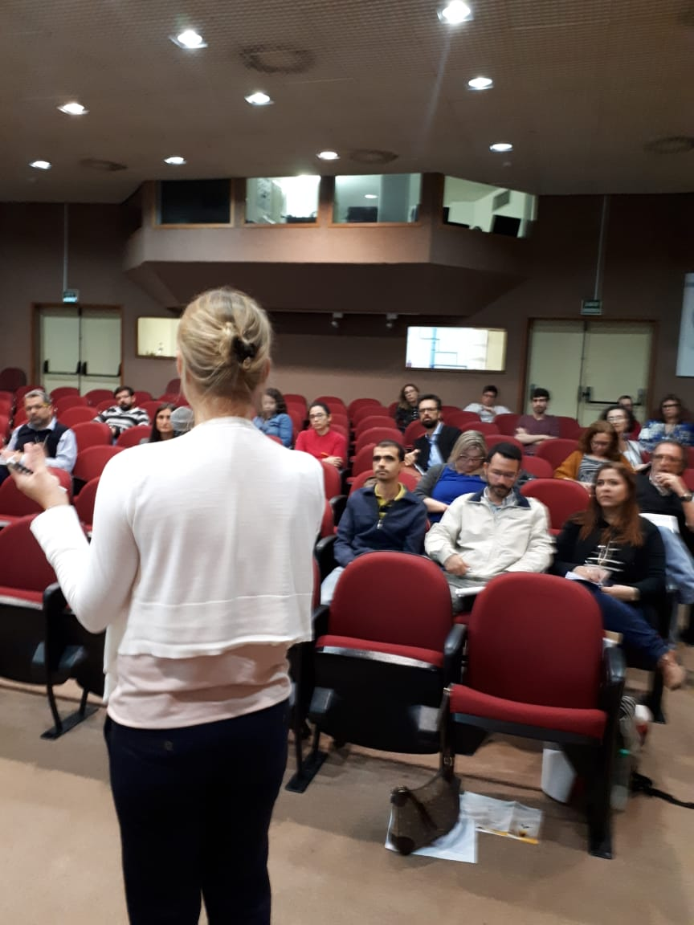
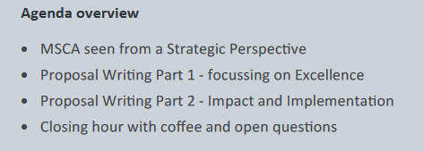
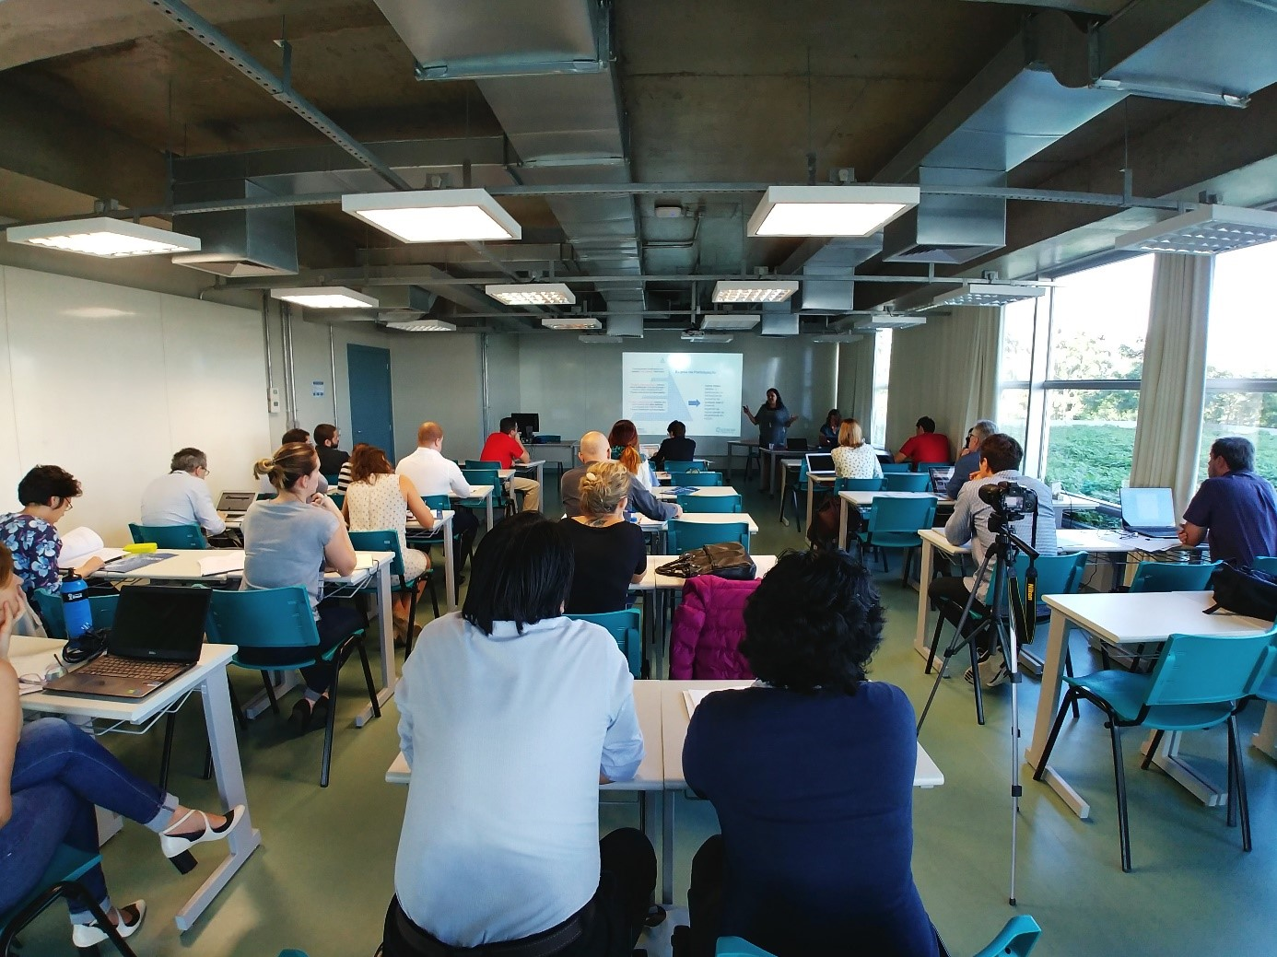
ENRICH services
TRAINING & INFRASTRUCTURE I.
Training 2018: 'How to apply for ERC Grants’ August 2018 Rio de Janeiro
45 researchers and multipliers participated; agenda included information about the ERC funding lines, how to apply for funding, the evaluation process and how to budget a proposal; practical exercises on abstract writing, the role of ERC reviewers in the evaluation process and the identification of eligibility criteria.
Sucess story of a Brazilian ERC Grantee Dr. Bernardo S. Franklin who works at the University Clinic Bonn (Germany)
Training 2018: How to write H2020 proposals? - Focus on MSCA IF
May 2018, Campinas and Porto Alegre
Notes:
Successful trainings in 2018

Slide 7
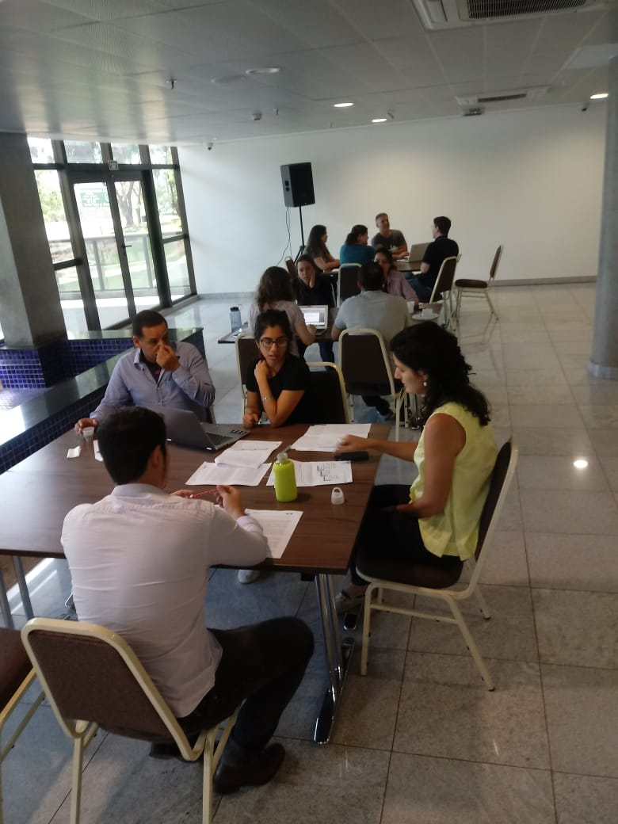
ENRICH services
TRAINING & INFRASTRUCTURE II.
Training on Impact Evaluation of R&I Programmes – December 2018, Brasilia
The training course gave the participants the opportunity to explore the foundations and re-cent developments of impact evaluation of policies, programs and institutions in the field of research and innovation. The training was structured into four main pillars:
- fundamentals of STI evaluation
- planning and conducting STI evaluation
- applied methodologies and
- setting-up an evaluation

Slide 8
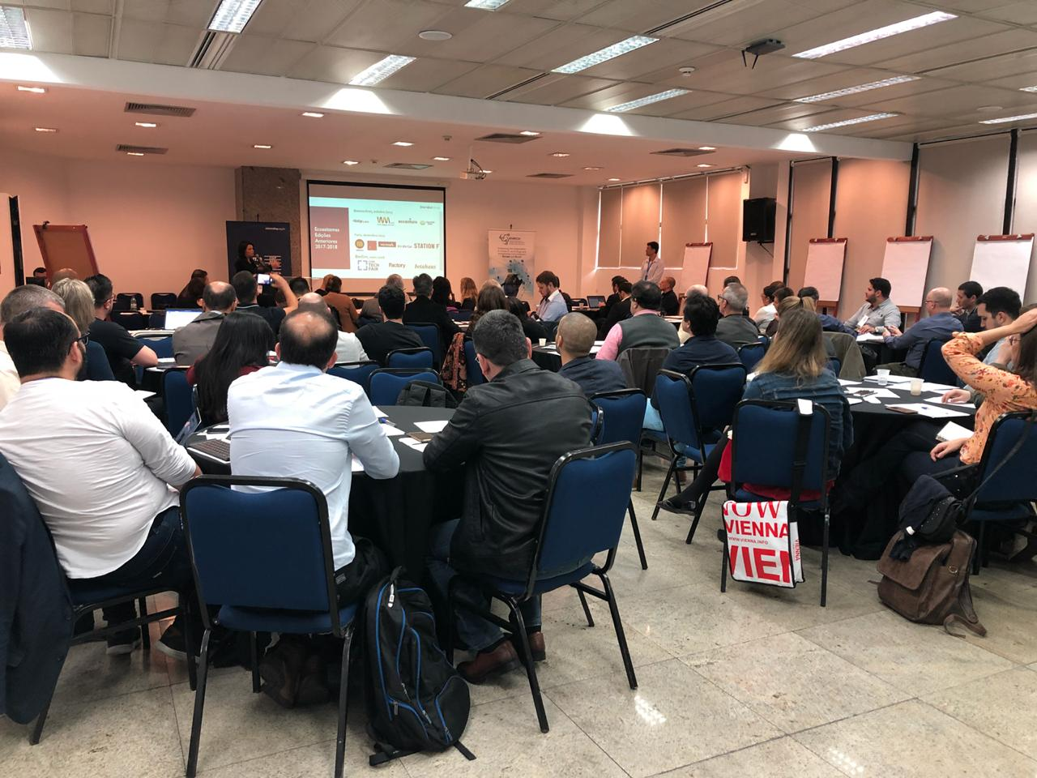
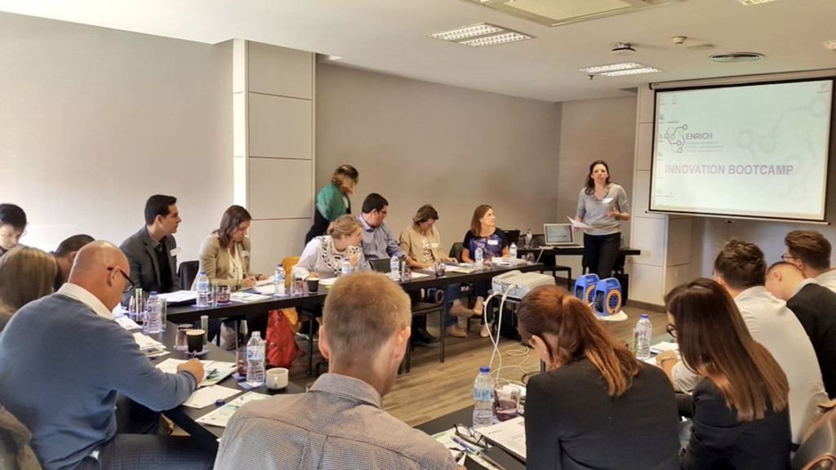
ENRICH services
TRAINING & INFRASTRUCTURE III.
Innovation Bootcamp BR: Curitiba, September 2018
Topics: innovation ecosystem in EU & BR; financial support instruments and
investment opportunities; Information and dissemination about the actors,
products, services and processes offered by ENRICH; Networking and pitch
sessions for startups and researchers
Innovation Bootcamp EU: Malaga, November 2018
Agenda: Background to business environment – Brazilian context - market and industry, business plan writing, business skills & legal advice, marketing, networking and teambuilding challenge; Pitch session & partner search advice
Notes:
Another type of training service: Bootcamp in Brazil and in Europe:
Curitiba: presenting the innovation ecosystem, financial support instruments, investment opportunities.
Malaga, introducing business environment in Brazil, with practical excercises: business plan writing, marketing, legal advice, networking and pitching session, etc. – for researchers, start-ups…

Slide 9
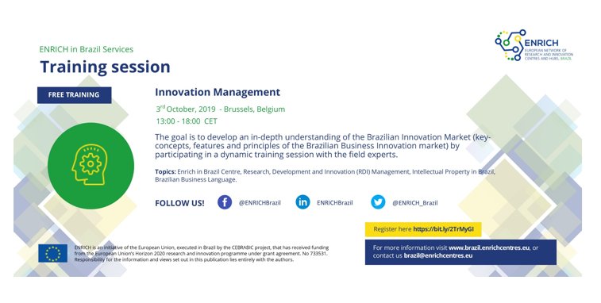
ENRICH services
TRAINING & INFRASTRUCTURE IV.
Training 2019: Innovation Management
Notes:
Training in 2019 , on Innovation management in Brussels, Belgium

Slide 10

ENRICH services
TRAINING & INFRASTRUCTURE V.
Innovation Bootcamp 2019
Notes:
The purpose of the 2nd Bootcamp Innovation Brazil was to present to Startups, Researchers, Entrepreneurs, Investors, and Corporates what tools, good practices and tips can be used to effectively internationalize businesses and innovation in the European Union, with the support of the ENRICH initiative
The Innovation Bootcamp in Brazil / Curitiba
With renowned speakers
Success stories:. Lucas Pinsdorf, Business Development manager at Mercado Bitcoin, the lagest criptocurreny bank in Latin America
Alessio Alionco, Founder and CEO of Pipefy, a Brazilian platform which facilitates the creation and organization of processes - used by more then 15 thousand companies, in more than 140 countries
Toolbox: Going International in Europe – Requirements, Policies and Tools
The European Technology and Innovation Market
Building your Internationalization Plan to Europe
Pitching in Europe for Going International
Target group: startup owners, researchers and university representatives,

Slide 11
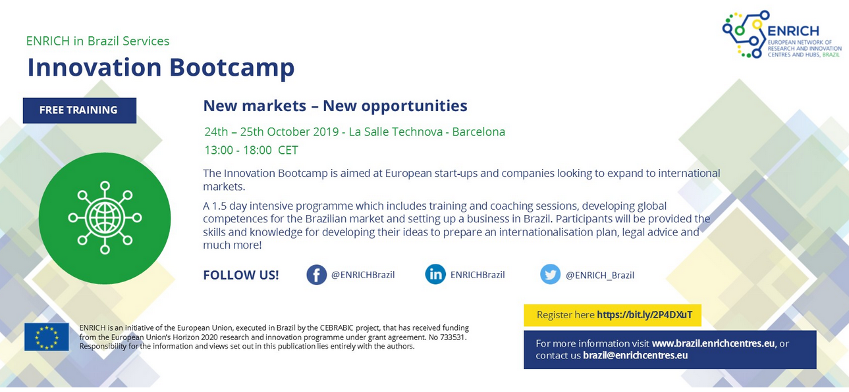
ENRICH services
TRAINING & INFRASTRUCTURE VI.
Innovation Bootcamp 2019
Notes:
A 1.5 day intensive programme which includes training and coaching sessions, developing global competences for the Brazilian market and setting up a business in Brazil. Participants will be provided the skills and knowledge for developing their ideas, legal advice and much more!
This ‘ENRICH in Brazil’ Innovation Bootcamp is aimed at European start-ups and companies looking to expand business to Brazil or to start collaboration with Brazilian entities.

Slide 12


ENRICH services
MATCHMAKING & EVENTS I.
Innovation tour to Brazil 2018
Notes:
2018 Innovation tour to Brazil – target group: business entities, R2M org., research organizations
Focus topics: Bioeconomy & Biotechnology, Nanotechnology & Material Science, (renewable) Energy
Location: Sao Paulo, Belo Horizonte, Rio de Janeiro
Participation was free for selected participants, however excluding travel costs.

Slide 13

ENRICH services
MATCHMAKING & EVENTS II.
Innovation tour to Brazil – September 2019 in Foz de Iguaçu / Curitiba
Focus topics: Bioeconomy & Biotechnology + Energy
Notes:
Innovation tour 2019 unique networking opportunity for European organizations operating in the area of Biotechnology, (Renewable) Energies and technologies
The five-day tour through the state of Paraná, namely Curitiba and Foz do Iguaçu, includes visits at top technology organizations, matchmaking session and the participation at the ANPEI Conference, known as one of the main conferences in Brazil when it comes to Innovation.
Attend Business Roundtables,visit top Technology organisations and gain insights into the cutting edge research and technology in Brazil.
Participation fee was 180 EUR – includes visits, workshops, lectures and catering (lunch, breaks, dinner)

Slide 14

ENRICH services
CONSULTANCY SERVICES
Customised support: tailor-made consultancy support on demand, incl.:
• Advice on Responsible Research and Innovation (RRI)
• Advice on branding
• Advice on communication
• Advice on technology transfer
• Advice on internationalisation
• Market analysis / Specific sector analysis
• Legal advice
• Advice on international investments
• Benchmarking studies
• Advice on developing business model and plan
• Advice knowledge management
• Organisation of business mission
• Organisation of roundtables and matchmaking sessions
Notes:
The consultancy services are custom-tailored

Slide 15

ENRICH services
SERVICE CATALOGUE 2019
Detailed information on our services:
http://brazil.enrichcentres.eu/news/service-catalogue-2019-
(The catalogue for 2020 will be available soon)

Slide 17


THANK YOU FOR YOUR ATTENTION!
Zita Buday Senior International Expert
Regional Centre for Information and Scientific Development
zita.buday@rcisd.eu
www.rcisd.eu

