Slide 1

ENRICH in the USA SERVICES
Ildikó Dorogi
International Expert
Regional Centre for Information and Scientific Development, www.rcisd.eu

Slide 2
ENRICH Services
WHAT IS THE ADDED VALUE OF ENRICH TO MY ORGANISATION?
Tailor-made services with an in-depth knowledge of the US research, innovation and business ecosystem
Effective support to achieve a dynamic presence in the US
Contacts and collaborative opportunities with key organisations in the US
Improved understanding and more efficient use of existing infrastructure and technological resources in the US
Active exploitation of funding and business opportunities in the US
Notes:
Support and connect European R&I and business organisations to the US
Contributes to the creation of research and business opportunities for European organisations in the US market

Slide 3
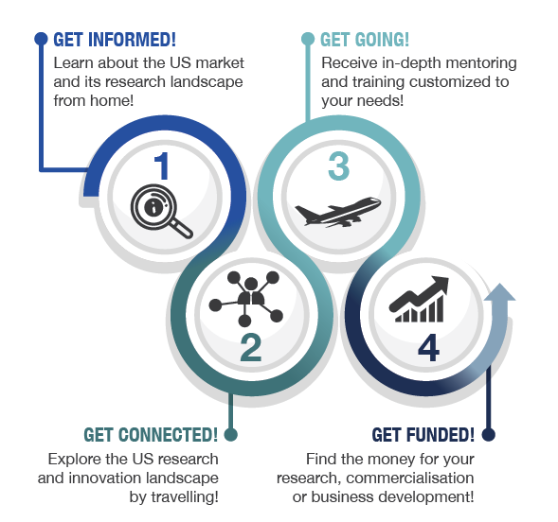
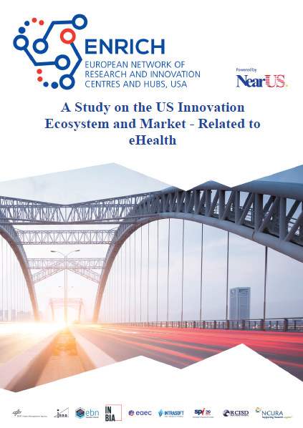
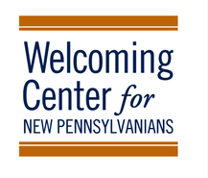
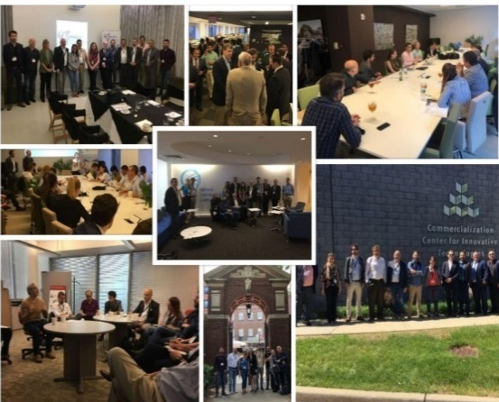
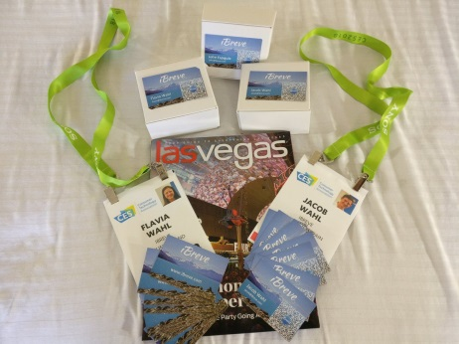

ENRICH Service Portfolio
ENRICH in the USA Experience ̶ Your Journey
Notes:
ENRICH in the USA offers entrepreneurial journey for researchers and innovators by providing services at the different stages.
The first step gathers all the ENRICH in the USA tools accessible online and training given in Europe, such as Webinars, Training
The second step is focused on “multipliers” and early projects. The main goal of these services is to introduce the European target groups to the US R&I landscape and establishing long-term EU-US research collaborations. The Get Connected services include Innovation Tours, Research Symposia.
The third step proposes more in-depth and personaliszed training and mentoring to researchers and entrepreneurs. It includes the following services: Research Commercialisation, (RC) Bootcamp, Hot Desks. This step aims at receiving support for establishing products in the US market.
The aim is to provide Europeans funding and investment opportunities in the US. It includes Match&Pitch events and the Business Acceleration Programme.

Slide 4




ENRICH Service Portfolio
Clustered by Service Categories
Innovation Market Studies
Research Thematic Studies
First Aid Information Kit B2B
First Aid Information Kit R2R
Webinars
Hot Desks
Trainings on Internationalisation
Innovation Tours
Matchmaking & Pitching Events
Entrepreneurial Skills Development Program
Bootcamps
Business Acceleration Programme
Media Training
Notes:
ENRICH USA offers services in 4 categories: …
I will present you all services briefly

Slide 5

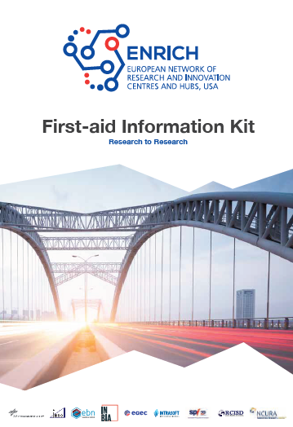
Information Services
1. Market and R&I Studies
Identify key innovation hubs/facilitators and industry related centres, US market opportunities and barriers
Possible ways of approaching the US market/research community
Available sources, assessment of the US research community landscape
Specific thematic studies are available here:
www.usa.enrichcentres.eu/innovation-market-studies
www.usa.enrichcentres.eu/thematic-research-studies
2. First Aid Information Kit
Booklets: www.usa.enrichcentres.eu/information-services
Notes:
Several Market and R&I studies are available on the Enrich USA webpage. Each study focuses on a specific innovation/market area (e.g., e-Health; Nanotechnologies).
The Innovation Market Studies identify US key innovation hubs/facilitators and industry related centres, as well as the US market opportunities and barriers. Possible ways of approaching the US market/research community.
The Research Thematic Studies provide an assessment of the US research community landscape and aim to support research and innovation cooperation between the EU and the US.
The studies can be an effective source or tool for you to gain knowledge on the US research community, US market and to:
Identify potential approaches for developing collaborative partnerships with US businesses; collaborative projects with US researchers
Find for you relevant US networks and conferences
access US funding programmes
R2R, B2B Aid Information Kit booklets contain several guidelines with essential information on entering the US market

Slide 6

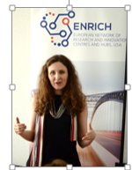
Guidance Training and
Infrastructure I.
1. Webinars
Information about thematic research actions
Critical aspects of research and market areas that are potential opportunities
for cooperation between the EU and the US
Registration through the ENRICH in the USA website
Past webinars:
  ENRICH in the USA Services
  ENRICH in the USA Renewable energies
  ENRICH in the USA Production Technologies
  ENRICH in the USA and ENRICH in CHINA on Connected and Automated Driving
2. Training on Internationalisation
”How to internationalise to the USA” throughout Europe,
how to successfully create relevant partnerships in the US
Half-day training
Launching throughout the year in different European countries
Notes:
Short Webinars (not more than 2 hours) offer information about research thematic actions and innovation market aspects that are useful for transatlantic cooperation
highlighting critical aspects of research and market areas that are potential opportunities for cooperation between the EU and the US.
The webinars are focused on specific fields or sectors
ENRICH in the USA is organising a set of training events on “How to internationalise to the USA” throughout Europe
The trainings provide you information about the US market, its main challenges and opportunities from the European perspective, and support on how to successfully create relevant partnerships in the US.

Slide 7
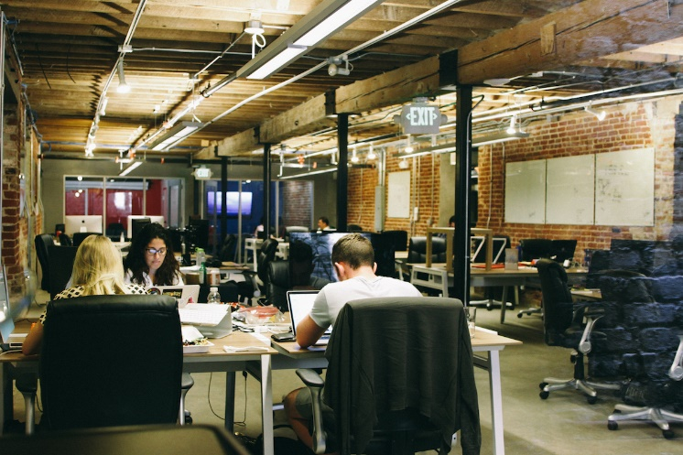
Guidance Training and
Infrastructure II.
3. Hot Desks
→ West Coast Centre Hot Desk in San Francisco
→ East Coast Centre Hot Desk in Boston
10 accepted applications per year
Supporting the exploration phases and set-up of promising EU researchers and deep-tech/deep-science entrepreneurs, startups and SMEs
Offering access to a collaborative workspace founded on the principle that people work better together with other like-minded people
Available for one person for up to a two-week period
Budget: Total 700 EUR desk and support
Application is ongoing
Notes:
NearUS provides work space, infrastructure and secondment opportunities to private and public European
organisations coming to the US and seeking a landing hub
supporting the exploration phases and set-up of promising EU researchers and deep-tech / deep-science entrepreneurs, startups and SMEs
ENRICH in the USA is offering access to a collaborative workspace founded on the principle that people work better together with other like-minded people
Hot desks available for one person for up to a two-week period in San Francisco or Boston.
Coworking aim is to gather a group of people who working independently, but share values and are interested in the synergy that can happen from working with other people working in the same place.
The funding covers the cost of the desk and support but does not cover additional costs such as travel and accommodation expenses.

Slide 8


Matchmaking and Events I.
1. US Innovation Tours
Encouraging the commercialization of promising EU research and technologies
Gaining an understanding of the local US ecosystems
Receiving live feedbacks on your project(s)/prototype/business plan
Meeting potential strategic partners, sharing good practices
Exploring funding and investment opportunities
Lasting 5 days
The costs for the venue, materials,
catering are covered
Notes:
ENRICH in the USA Innovation Tours are the first step for you to encourage the commercialization of your promising EU research and technologies.
The Innovation Tour offers you the following great opportunities, you will:
- understand the local US ecosystems that supports the commercialization of R&I
- receive live feedbacks on your project(s)/prototype/business plan
- meet potential strategic partners and share good practices
- explore funding and investment opportunities in the US
The Innovation Tours lasts 5 days
The costs for the venue, materials, catering are covered but does not cover additional costs such as travel and accommodation expenses.

Slide 9
Matchmaking and Events I.
2. EU Innovation Tours
Sector-focused tour in the EU with representatives of ENRICH in the USA Centres and Hubs, ENRICH Ambassadors, investors, etc.
Bringing the ENRICH in the USA and the US ecosystem closer to European R&I entrepreneurs
Providing first-hand information and training to Europeans’ benefit
10 US participants with over 80 EU stakeholders
Notes:
One sector-focused tour with representatives of ENRICH in the USA Centres and Hubs, ENRICH
Ambassadors, investors, etc. from the US to different locations in the EU will be organised.
The aim is to bring the ENRICH in the USA and the US ecosystem closer to European R&I entrepreneurs to overcome barriers to travel to
the USA directly and provide first-hand information and training to Europeans’ benefit.
The service targets at least 10 US participants and establish meetings with over 80 EU stakeholders.

Slide 10
Matchmaking and Events I.
3. US Custom Tours
3 tours will be organized
Focusing on smart specialization concentrations (advanced manufacturing, food and beverage, and smart city)
Consist of at least 10 participants per tour
Notes:
Three tours will be organised, which focus on smart specialization concentrations (advanced
manufacturing, food and beverage, and smart city), consist of at least 10 participants per tour, for a total minimum
participation of 30 EU stakeholders

Slide 11
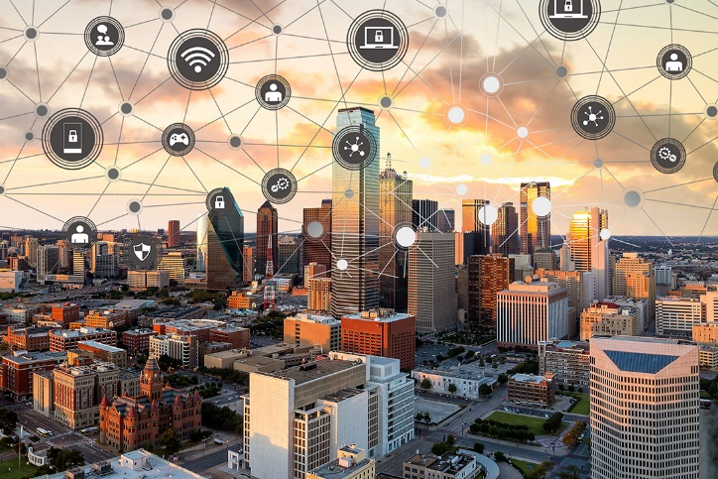
Matchmaking and Events I.
OPEN CALL: USA Smart City-focused Tour
November 11– 15, 2019 in Dallas, Texas
Call closes: October 28, 2019
Providing European stakeholders access to IoT and other smart technologies
Giving the opportunity to meet with potential customers and secure real-world demonstration sites in a breadth of smart city applications
Ideal for smart city-interested stakeholders from
R&I, business organizations, government officials,
cluster coordinators, smart city specialization experts
seeking a “sister city” from another federal government
Reduced participant fee: 675€ (instead of 2200€)
Notes:
ENRICH in the USA is launching a Smart City-Focused Tour in Dallas, Texas to assist European Countries smart city stakeholders in connecting to early adopters, and/or finding an ideal US demonstration site for relevant solutions in urban IoT infrastructure serving massive populations.
It provides European stakeholders access to IoT and other smart technologies.
This service gives you the opportunity to meet with potential customers and secure real-world demonstration sites in a breadth of smart city applications
Make introductions to and procure networking opportunities to strategic corporate stakeholders and government officials who deployed the smart city initiatives of the Dallas region, and investors integral to the US smart cities/IoT market
The Tour is ideal for
- smart city-interested stakeholders from research, innovation, and/or business organizations from the EU
- Government officials, cluster coordinators, and/or other smart city specialization experts from the EU seeking a “sister city” from another federal government for their research and innovation stakeholders to collaborate with, are also welcome to foster connections from the Tour.

Slide 12
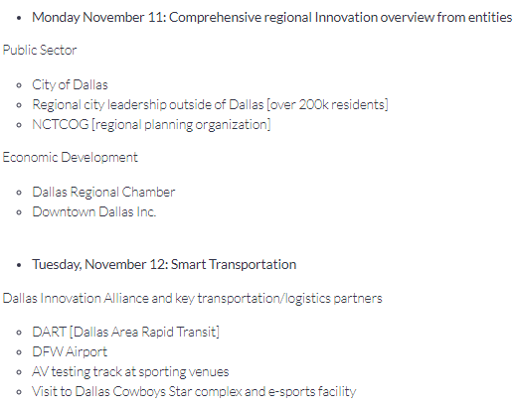
Matchmaking and Events I.
Agenda

Slide 13
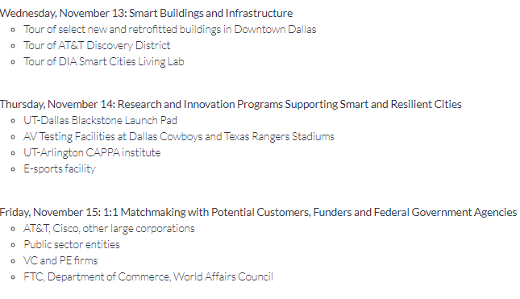
Matchmaking and Events I.
Agenda

Slide 14
Matchmaking and Events II.
4. Matchmaking & Venture Capital Pitching Events
For participants looking for partnering and investment opportunities
Creating opportunities to introduce to early stage focused investors during a pitch session
Co-organizing with EEN Matchmaking events with partners, buyers, investors, state and local governments, angel networks, reputed investors, Fortune 500 companies
Notes:
ENRICH in the USA’s Match&Pitch events are bringing local, national, and international businesses under one roof.
The event is for Participants looking for partnering and investment opportunities
We offer events that create opportunities for you to be introduced to early stage focused investors during pitch session.
You will present your early R&D project for tech transfer and licensing opportunities to US corporate partners.
Enrich USA co-organizes with Enterprise Europe Network (EEN) Matchmaking events with partners, buyers, state and local governments, angel networks, reputed investors, Fortune 500 companies

Slide 15
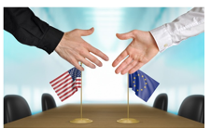
Matchmaking and Events III.
5. Entrepreneurial Skills Development Program (ESDP)
OPEN CALL: 19-24 March, 2020 - Philadelphia, PA, USA
Call closes: 31 January, 2020
In conjunction with the American Chemical Society’s National Spring Meeting
Providing a 3-day technical training and info session on crucial topics for entering the US market
Matching to experts from science and business
Network throughout the Program (catering)
Reduced training fee: 50€
Notes:
The ESDP will take place in Philadelphia, PA, USA on 19th – 24th March 2020, in conjunction with the American Chemical Society’s (ACS) National Spring Meeting.
The Program will provide a 3-day technical training and info session on crucial topics for entering the US market, before the ACS conference.
Prior to the program you will be matched to highly-qualified experts from science and business as your ENRICH-mentor tailored to your specific needs.

Slide 16
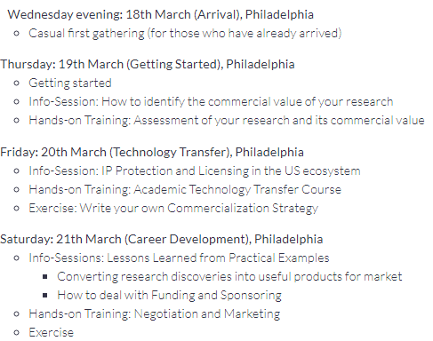
Matchmaking and Events III.
Agenda

Slide 17
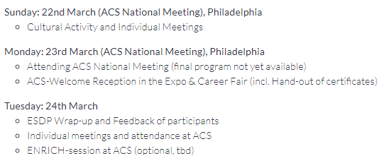
Matchmaking and Events III.
Agenda

Slide 18

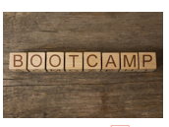
Advice and Coaching I.
R2C and B2B Bootcamps
10 days for startups/researchers interested in commercializing technologies
10 days for SME’s interested in connecting to business opportunities in the US
Pre-Departure Training: For 2 days preparing participants in the Annual Bootcamps, focusing on critical success factors for cracking the US market.
Bootcamp Phase 1: For 6 days working with entrepreneurs in similar industries, meeting industry relevant stakeholders, receiving
business development training, etc.
Bootcamp Phase 2: 3 days of additional networking
and training
Notes:
ENRICH in the USA organizes 10 day Research CommercializationB2B Boot Camps for motivated startups and researchers interested in commercializing technologies/connecting to business opportunities in the United States.
This serivce offers:
- 2 days long Pre-Departure Training: prepare participants for the Annual Bootcamp. The workshops focuses on critical success factors for cracking the US market. The topics cover Understanding the US market, growth opportunities, Understanding the American way of doing business, Market research and business plan development
, etc. Each participant will then have an opportunity to practice once again their company pitch. Participants will have the opportunity to network with corporate executives, investors and other stakeholders.
Bootcamp Phase 1: Participants will travel to a Landing Hub site. For 6 days participants will work entrepreneurs in similar industries, receiving additional business development training, learning about local resources, local entrepreneurial ecosystem.
Bootcamps Phase 2: For 3 days of additional networking and training. take place concurrently with the annual HUB Week, a startup, technology and cultural event in Boston which attracts over 10,000 attendees A 2-hour pitch review session will be offered. It is also possible to network with corporate executives, investors and other stakeholders

Slide 19
Advice and Coaching I.
2. Sector-Specific Business Boot Camps
7 one-week Boot Camps in the USA landing hubs an 2 more locations
Providing Europeans access to local, industry-relevant customer and investment leads advice towards financially efficient paths, lower business development costs and uncertainties in entering the US market
Targeting Europeans who own post-revenue technology start-ups and SMEs
Hosting at least 7 participants per Bootcamp
Notes:
Seven one-week Boot Camps will be organised at ENRICH in the USA landing hubs and two more locations
to provide Europeans access to local, industry-relevant customer and investment leads as well as advice towards timely, financially efficient paths to gain market traction within that community’s ecosystem, lower business development costs and uncertainties in entering the US market. This service targets Europeans who own
post-revenue technology start-ups and SMEs. Each Boot Camp will host at least 7 participants per Bootcamp

Slide 20
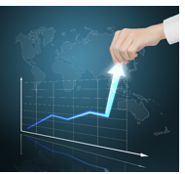
Advice and Coaching II.
3. Business Acceleration Programme
Helping to prepare market entry/development plan, connect with the
#1 Business / Corporate Development “all-tech” ecosystem, and to identify
ideal investors, partners and customers to build US activity upon/with
3 months of tailored and interactive curriculum and program (services)
Live feedbacks from mentors/advisors and potential investors
Support to find seed funding opportunities in the USA
Introduction to potential technological and financial partners
Participation in a one-week trip in San Francisco to confirm
introductions and interviews
Notes:
The goal of the program is to help you prepare your market entry/development plan and then connect with the #1 Business / Corporate Development “all-tech” ecosystem in the world, and to identify ideal investors, partners and customers to build your US activity upon/with.
The BAP gives you the opportunity of:
3 months of tailored and interactive curriculum and program (services)
Live feedbacks from mentors/advisors and potential investors.
Support to find seed funding opportunities in the USA (including equity based accelerators).
Introduction to potential technological and financial corporate partners.
Participation in a one-week trip in San Francisco to confirm introductions and interviews.

Slide 21

Opportunities - Open calls!!!
ENRICH in the USA Smart City-Focused Tour - November 11– 15, 2019
Entrepreneurial Skills Development Program (ESDP) - March 2020
Hot Desks available at ENRICH in the USA East Coast Centre - Ongoing
Hot Desks available at ENRICH in the USA West Coast Centre - Ongoing
https://usa.enrichcentres.eu/opportunities

Slide 22




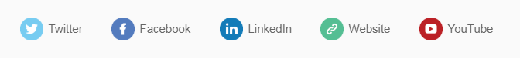
Various ways to stay informed
Thank you!
Ildikó Dorogi
International Expert
Regional Centre for Information and Scientific Development
www.rcisd.eu
General Enquiries:
usa@enrichcentres.eu | www.usa.enrichcentres.eu

