Slide 1

ENRICH in Brazil EU H2020 project
Zita Buday Senior International Expert
Regional Centre for Information & Scientific Development
ENRICH in Brazil Info-Day
Ivano Frankivsk, 17 October 2019
www.brazil.enrichcentres.eu
brazil@enrichcentres.eu
Notes:
A short overview on the ENRICH in Brazil centre / CEBRABIC project

Slide 2


CEBRABIC Project establishes ‘ENRICH in Brazil’
Horizon 2020: ENG-GLOBALLY-9-2016, Centres/Networks of European research and innovation: Establish strategic Partnerships in Science, Technology and Innovation (STI) with selected key countries: China, USA, Brazil (Pilots)
CEBRABIC (Brazil): 01/2017 – 12/2020 Centre for Europe-Brazil Business and Innovation Cooperation
Main Objectives of CEBRABIC:
Encouraging cooperation among European and Brazilian Research, Innovation and Business (R&I&B) organizations
Establish and deploy a self sustainable Centre for Europe-Brazil Business & Innovation Cooperation within 48 month
©Fotolia
Notes:
ENRICH in Brazil is the European Network of Research and Innovation Centres and Hubs in Brazil – established in the frame of the Horizon 2020 „CEBRABIC” project, working to enhance cooperation in research, technology and entrepreneurship between Europe and Brazil
(aiming to become the main hub and contact point for European and Brazilian Science, Technology and Innovation Actors. The Centre will encourage and facilitate the cooperation in research, technology and entrepreneurship between Europe and Brazil by supporting and empowering all innovation actors (public & private) along the innovation (value) chain.)

Slide 3











CEBRABIC Consortium: 12 Partner Organisations (Brazil & Europe)
Who
we are!
BALANCED INSTITUTIONAL DIVERSITY
Companies (SPI, RCISD)
Universities (UNICAMP, SU)
Funding agencies (FFG)
R&I organizations (FHG, DLR)
Not-for-profit organisations
(ANPEI, CONFAP, CNI, EBN, IASP)
Coordinator
8 Partners
4 Partners
Notes:
4 consortium members in Brazil
8 in Europe – RCISD as only one from the new member states

Slide 4
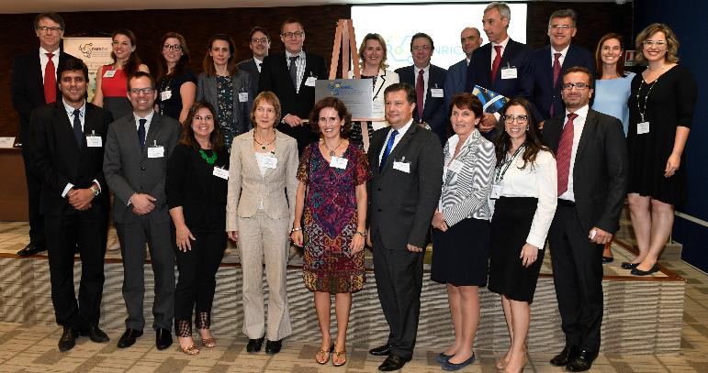
‘ENRICH in Brazil’ Official Opening in Brasília – 29th November 2017
M48
M1
M13
M25
Planning Phase
Piloting Phase
Full Implementation Phase
Post
Project
CEBRABIC Project Phases
Notes:
Inauguration event in Brasilia,
Some statistics: Project lifetime 4 years / 48 months
At present: the project is in the Piloting Phase, offering services free of charge
M 25 – 48: full implementation phase, cost-based, expected to achieve financial self-sustainability.
Post project: completely self-sustainable
Expected to remain in the long-run as the coordinating pillar for successful and sustainable international collaborations of its customers.
ENRICH in Brazil centre: legal entity, association – RCISD is a founding member of the association

Slide 5
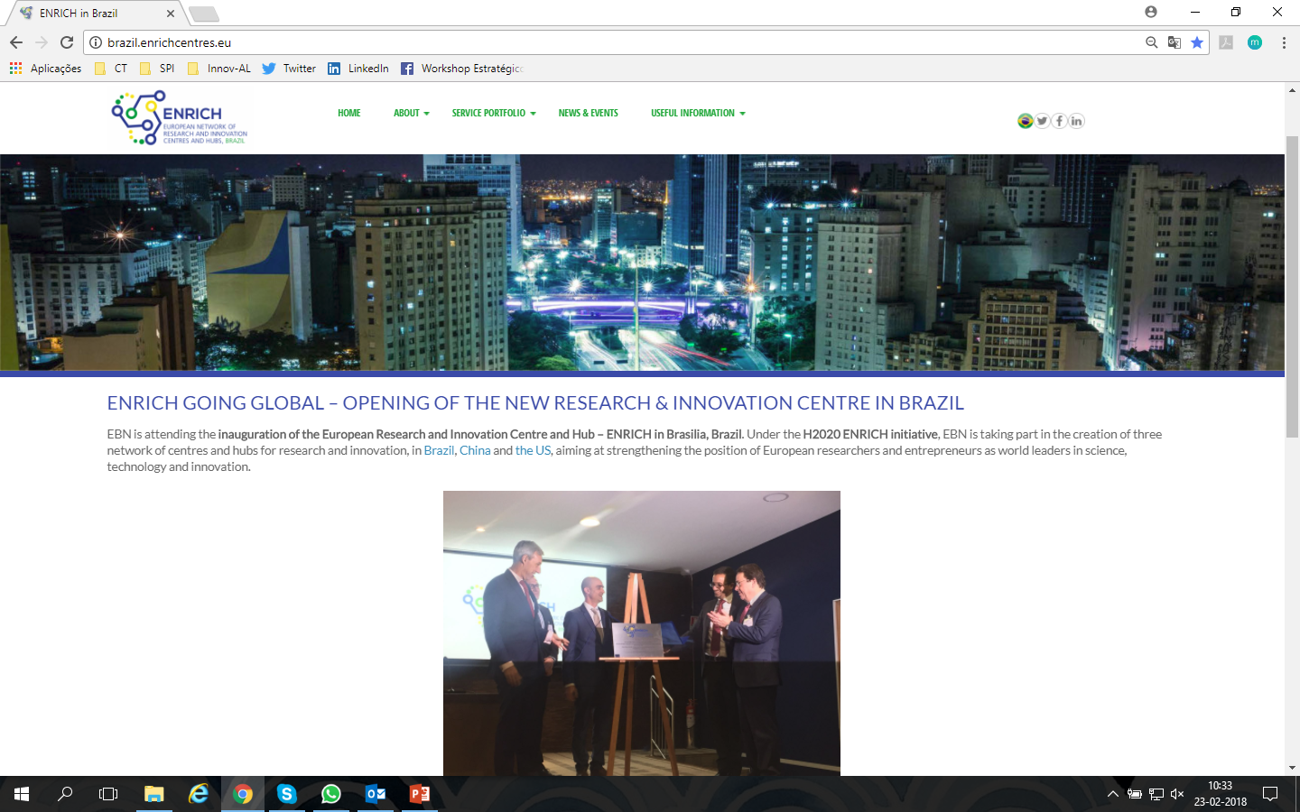
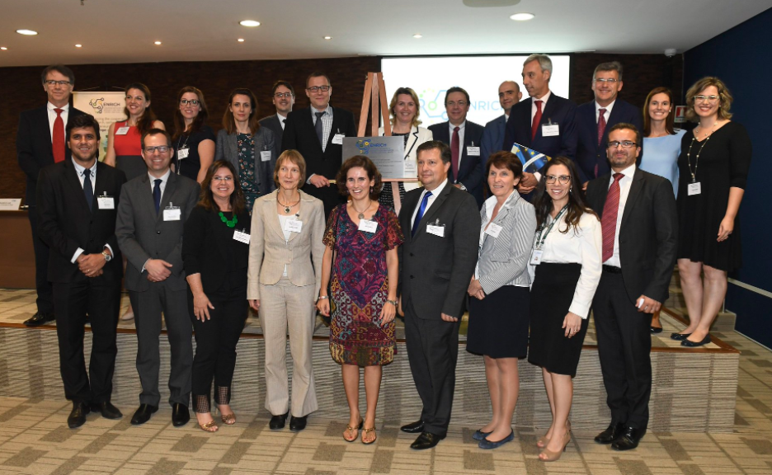
‘ENRICH in Brazil’ Official Opening in Brasília – 29th November 2017
Inauguration Event: Brasília, November 2017
Notes:
The first major milestone: Opening ceremony of the ENRICH Centre with the participation of high-level politicians, among others the Ambassador of the European Union to Brazil, and Head of department ST of the Brazilian Ministry of Foreign Affairs.

Slide 6

ENRICH in Brazil: Our Promise to the Market!
European Network of Research and Innovation Centres and Hubs, Brazil
BECOMING THE MAIN HUB & CONTACT POINT FOR EUROPEAN &
BRAZILIAN SCIENCE, TECHNOLOGY & INNOVATION ACTORS
MISSION
VISION
OBJECTIVES
Promotion of excellence in B&R&I
Financial sustainability of the Centre
Creation of a win-win situation for BR & EU in STI fields
Connect EU researchers & entrepreneurs in BR market
Connect BR researchers & entrepreneurs in EU market
Offer Services to BR & EU clients
Integrate existing EU & BR initiatives, projects and networks
We encourage & facilitate the cooperation in research, technology and entrepreneurship between Europe and Brazil by supporting and empowering all innovation actors (public & private) along the innovation (value) chain
In 2021, 'ENRICH in Brazil' will be a main hub & contact point for European and Brazilian Science, Technology and Innovation (STI) actors aiming at bilateral cooperation
Notes:
Mission:
Vision:
Objectives:

Slide 7



ENRICH in Brazil: Main Pillars to put Vision/Mission into Practice
Vision
Mission
Services
Structure
Community
ENRICH in Brazil as Main Hub & Contact Point for
European & Brazilian STI Actors
Notes:
Services: portfolio explained later detailed
Structure: ENRICH Legal entity in Brasil (legal form: association) – ENRICH Focal point in Brussels / EU
Community: HQ, Service providers, beneficiaries (individuals & organisations), soft landing hubs, ambassadors

Slide 8


Clients – Beneficiaries - Stakeholder
For
whom?!
RESEARCH ACTORS
INNOVATION ACTORS
BUSINESS ACTORS
Universities
Research Institutes
University Associations
Research Networks
Scientific Parks
Incubators
Accelerators
Funding Agencies
Companies
Start-ups, SMEs
Business Networks
Clusters
Notes:
Research: European & Brazilian Universities, Research Organisations & Centres, Internationalization "Offices" at BR-Universities, single researchers, Association of Universities
Innovation actors:Science & Technology Parks, Competence Centres, Innovation Centres, Applied Research Institutes, Technology Transfer Organisations (TTO) / Centres, Incubators, funding agencies
Business actors:: Entrepreneurs, Start-ups, SMEs (MS/AC & BR), also large companies; business networks, clusters, etc.

Slide 9

Service Portfolio & Customer Value
How?!
ENRICH in Brazil Experience
1
6
i
GET INFORMED!
Relevant information – available on both a customized and general level – on doing business in Brazil and Europe, market & research studies, and upcoming events & fairs.
GET ADVICE!
Customized and top-shelf legal advice from experts on all relevant topics regarding the Brazilian & European markets and their challenges.
2
5
GET CONNECTED!
GET VISIBLE!
Find new, reliable contacts from within ENRICH’s extensive network, connecting to new partners and forming collaboration links.
Consultancy services aimed at raising visibility, supporting users to operate successfully in their chosen markets.
3
4
GET FUNDED!
Discover the latest funding opportunities, get specialised information based on customer needs and participate in focused matchmaking innovation events.
GET GOING!
Training sessions to get fully prepared for business in order to hit the ground running, as well as secondment & workspace opportunities in key cities in Brazil and Europe.
Notes:
The offered services from the customers’ aspect: types of different services
My second presentation will provide a detailed overview on

Slide 10
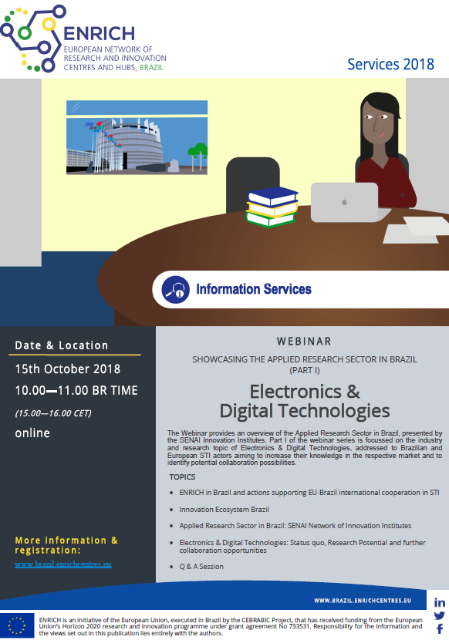
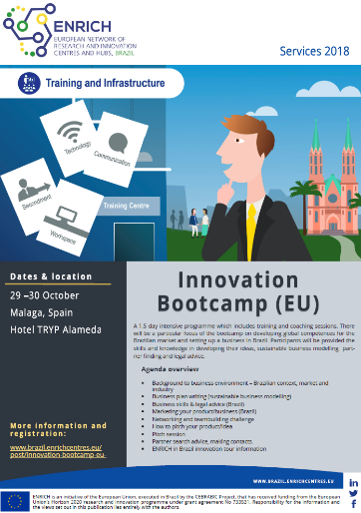
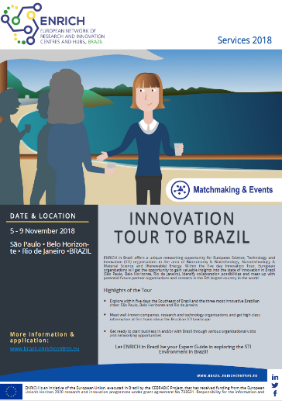
Spotlight on Services ( 2018)
11 & 15 Oct 2018
Webinars
29 & 30 Oct 2018
5 – 9 Nov 2018
Innovation Landscape & Culture in Brazil 11 October 2018 (15-16 CET)
Showcasing the Applied Research Sector in Brazil (Part I): Electronics & Digital Technologies
15 October 2018 (15-16 CET)
Notes:
Some of the services - delivered during the pilot period free of charge
Webinar on Brazilian innovation ecosystem
Bootcamp in Malaga, introducing business environment in Brazil, with practical excercises: business plan writing, marketing, legal advice, networking and pitching session, etc. – for researchers, start-ups…
Innovation tour to Brazil – target group: business entities, R2M org., research organizations
Focus topics: Bioeconomy & Biotechnology, Nanotechnology & Material Science, (renewable) Energy
Location: Sao Paulo, Belo Horizonte, Rio de Janeiro
Participation was free for selected participants, however excluding travel costs.

Slide 11


ENRICH in Brazil: Community
Brazil
& Europe
ENRICH in Brazil Ecosystem
Service
Provider
ENRICH
Supporters & Ambassadors
Headquarters
in Brasília & planned Branches in SP & RJ
Soft Landing
Hub
Individuals & Organisations
as Beneficiaries
Notes:
HQ in Brasilia – offices foreseen in Sao Paolo and Rio de Janeiro
Service providers: RDI coaches, experts, R&I agents, Business support providers, Legal experts (STI)
Service Providers will offer services under the umbrella of ENRICH in Brazil.
Soft landing hubs: Sci&Technology parks, Res. Centres, Incubators, Accelerators
Supporters & Ambassadors: European and Brazilian organizations interested in engaging with ENRICH in Brazil, as they see synergies and mutual benefits in promoting ENRICH services and activities to their networks.
Government actors (funding agencies, embassies, ministries, etc), existing project & initiatives funded by the EC and by brazilian funding lines, networks & nonprofit organisations

Slide 12






How to involve?
Become part of our Community: Application for Service Providers, SLH & Ambassadors via Website!
Test our Services as ‚free-of-charge‘ in 2018
Stay tuned about our Activities via Social Channels & Newsletter Subscription
www.brazil.enrichcentres.eu
brazil@enrichcentres.eu
https://twitter.com/ENRICH_brazil
https://www.facebook.com/ENRICHinBrazil
https://www.linkedin.com/company/11125511
FOLLOW
US!
Notes:
How you can get involved:

Slide 13

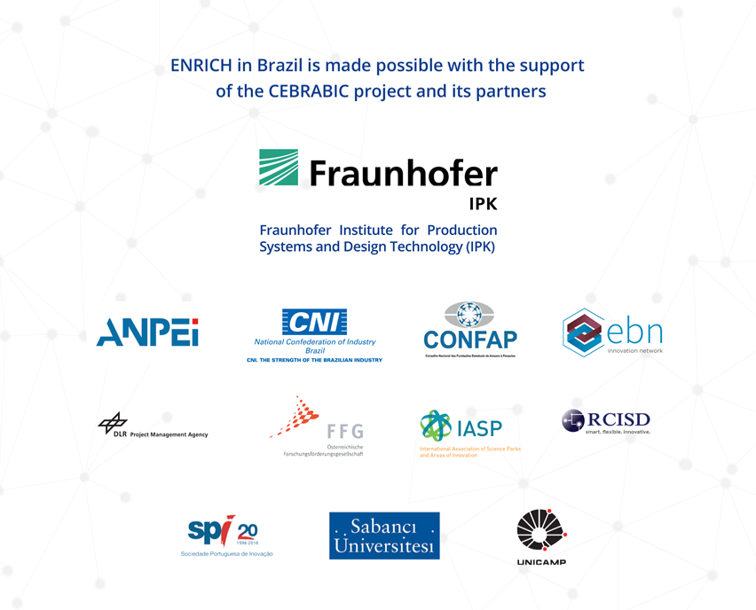

Slide 14
THANK YOU FOR YOUR ATTENTION!
Zita Buday Senior International Expert Regional Centre for Information and Scientific Development zita.buday@rcisd.eu www.rcisd.eu

