Slide 1
Meaning of Association Agreement (2014) for Ukraine (everything except Commercial aspects).
Yakymchuk Pavlo
Pr (m1) -03

Slide 2
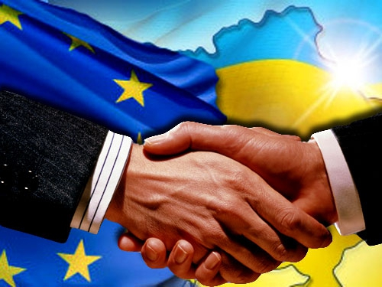
The European Union–Ukraine Association Agreement is a European Union Association Agreement between the European Union (EU), Euratom, Ukraine and the EU's 28 member states at the time (which are separate parties in addition to the EU). It establishes a political and economic association between the parties.

Slide 3
Preamble and Title I "General Objectives and Principles"
This part outlines the basis that exists today for the conclusion of the Association Agreement between Ukraine and the EU, in particular the recognition by the EU of the European choice and European aspirations of Ukraine as a European country sharing a common history and common values. including the establishment of an association, gradual rapprochement between Ukraine and the EU on the basis of common values, deepening economic and trade relations, in particular by creating a free trade area, strengthening cooperation in the field of justice, freedom and security. The basic principles that will underlie the association are established, first of all, the provision of human rights and fundamental freedoms, respect for the rule of law, respect for the principles of sovereignty and territorial integrity, inviolability of borders and independence. It is emphasized that further relations between Ukraine and the EU will also be based on the principles of a free market economy, the rule of law, effective governance, etc.

Slide 4

Title II "Political Dialogue and Reforms, Political Association, Cooperation and Convergence in Foreign Affairs and Security Policy"
This part contains provisions, the implementation of which should contribute to the development and strengthening of political dialogue in various fields, including the gradual convergence of Ukraine's positions with the EU in the field of foreign and security policy.

Slide 5
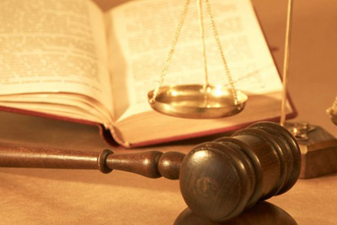
Title III "Justice, Freedom and Security"
This part of the Agreement defines the areas of cooperation in the relevant areas. An important goal of cooperation is to establish the rule of law and strengthen relevant institutions, in particular in the field of law enforcement and the establishment of justice, primarily to strengthen the judiciary, improve its efficiency, guarantee its independence and impartiality.

