Slide 1
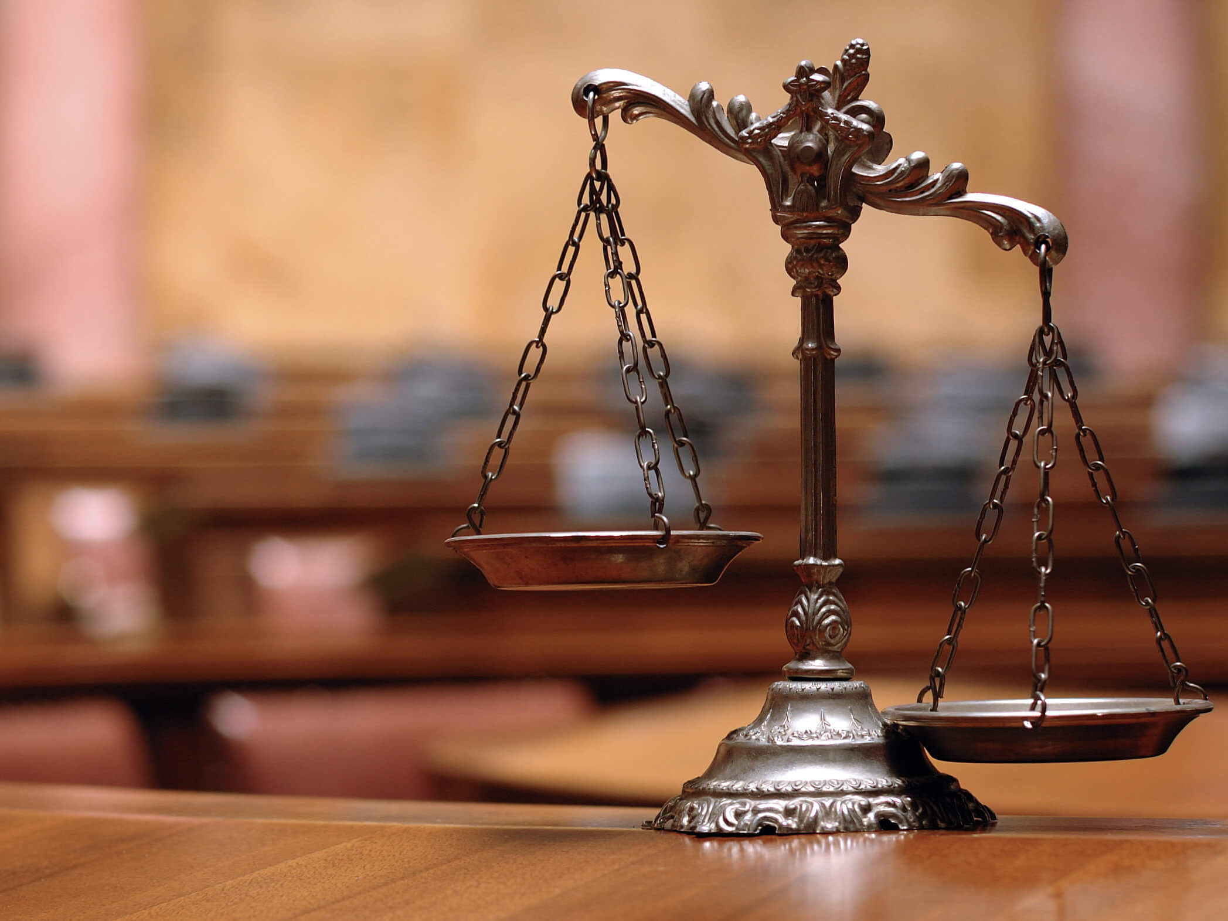
Cooperation with the EU in the field of Justice
Completed:
Student of group PR (m1) -03
Zavadetska Diana.

Slide 2
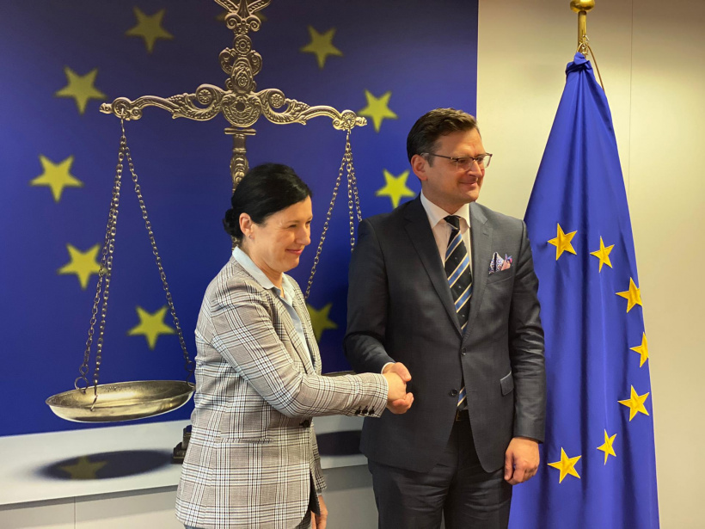
An important component of the formation of political association between Ukraine and the EU is to uphold the rule of law and strengthen institutions in the field justice, judicial and law enforcement system. St. 14 Association Agreements provides for cooperation in the field of justice, freedom and security in order to strengthening judicial and law enforcement agencies, increasing their efficiency, guaranteeing the independence and impartiality of the judiciary, fight against corruption, ensuring human rights and freedoms

Slide 3
Judicial system of Ukraine
Judicial system of Ukraine is characterized by the independence of the judiciary from the executive and legislative branches of government, a complex system of judges.
In the period 2014-2021, Ukraine made large-scale legislative efforts aimed at bringing the judiciary in line with the rule of law and strengthening the independence of the judiciary.

Slide 4
Judicial reform was implemented in three stages:
The first stage: in 2014-2015 the laws were adopted "On Restoring Confidence in the Judiciary in Ukraine" and "On Ensuring the Right to a Fair Trial", which deal with the most pressing issues of the judiciary and preceded the constitutional reform.
The Law of Ukraine “On Ensuring the Right to a fair trial ”provided: introduction of the institute qualification assessment of the professional level of a judge and inspection integrity of judges; introduction of a judge's file, which will contain all information about the judge and information about his career; improving the procedure special training of a candidate for the position of a judge; improvement of the institute disciplinary liability of judges; definition of a new order formation of the composition of the High Qualification Commission of Judges of Ukraine and the High the Council of Justice on transparent terms and on a competitive basis; installation the procedure for direct appeal with applications for review of court decisions to the Supreme Court of Ukraine
The law raises the minimum age for holding office from 25 to 30 years judges and at the same time introduces a system of competitive selection for appointment judges

Slide 5
Second stage: On June 2, 2016, the Constitution was amended and a new version of the Law "On the Judiciary and the Status of Judges" was adopted in order to bring the legal framework in the field of justice in line with European standards
This law: eliminated the Verkhovna Rada of Ukraine from process of appointment of judges, introduced indefinite appointment of judges for submission of the High Council of Justice, increased requirements for judges corps, increased the responsibility of judges by limiting immunity only to the functional
The most tangible and fastest change in the judicial system was partial abolition of judicial immunity.

Slide 6
Third stage: legislative acts "On the High Council of Justice", "On the Constitutional Court of Ukraine", new procedural codes and new legislation were adopted.
Law of Ukraine “On the High Council of Justice” of September 23, 2016 created a legal basis for the independence of the judiciary and its functioning on the basis of responsibility, accountability to society [16]. It determined the status, powers and organization of the work of the High Council justice, which is the main body in matters of judicial career, has the right to decide on the appointment, dismissal and transfer of judges, give permission for their detention, arrest, removal.

Slide 7
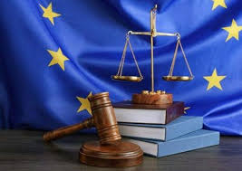
Law "On Restoration of Confidence in the Judiciary in Ukraine" adopted on April 8, 2014 covered most of the recommendations formulated by the conclusions of the Council of Europe experts, p in order to comply with European standards, in particular the right to a fair court that will guarantee the independence of the judiciary, legal certainty and equality before the law.

Slide 8
According to the Law "On Ensuring the Right to a Fair Trial" of 12 In February 2015, Ukraine carried out a comprehensive disciplinary reform responsibility of judges and relevant proceedings. This led to significant improvements aimed at accountability and legal certainty, predictability, fairness and impartiality disciplinary proceedings and imposition of sanctions

Slide 9
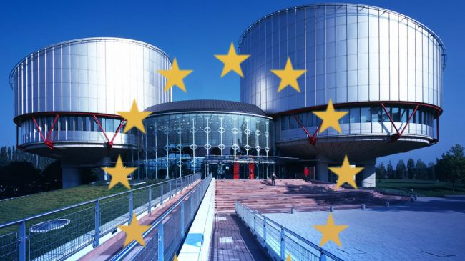
Law "On the High Council of Justice" of December 21 In 2016, it was established that disciplinary proceedings against judges would take place competence of the High Council of Justice. Disciplinary proceedings will be carried out by disciplinary chambers, most of which have to become judges. The rules for reviewing these disciplinary proceedings, which introduced into the Law "On the High Council of Justice", were previously assessed Council of Europe experts, and in general it was decided that the final text was in line CE standards. The adopted legal framework complies with the CE standards for determining the grounds for disciplinary responsibility, proportionality of sanctions and fairness proceedings.

Slide 10
Judicial reform presupposes a transition from a four-tier to a three-tier judicial system.
courts of first instance
courts of second instance
Supreme Court with integrated specialized courts of cassation.

Slide 11
Higher specialized courts have been established in the judiciary: the High Court of Intellectual Property and the High Anti-Corruption Court, which act as courts of first instance to hear statutory categories of cases
High Court of Intellectual Property
High Anti-Corruption Court
To the competence The High Court of Intellectual Property has disputes related to copyright, trademarks, patents for inventions, etc. Previously, these cases were considered by district and commercial courts
The Supreme Anti-Corruption Court ”exercises the following powers: - administration of justice as a court of first and appellate instances in criminal proceedings for crimes within its jurisdiction (jurisdiction) by procedural law, as well as by the implementation of cases and the order determined by the procedural law, judicial control over the observance of the rights, freedoms and interests of persons in such criminal proceedings; - analysis of judicial statistics, study and generalization of judicial practice in criminal proceedings under his jurisdiction, informing about the results of generalization of judicial practice of the Supreme Court and provide it with proposals for conclusions on draft legislation acts relating to the organization and activities of the Supreme Anti-Corruption court, special requirements for judges of this court and guarantees of their activities, and also publish them on its official website

Slide 12
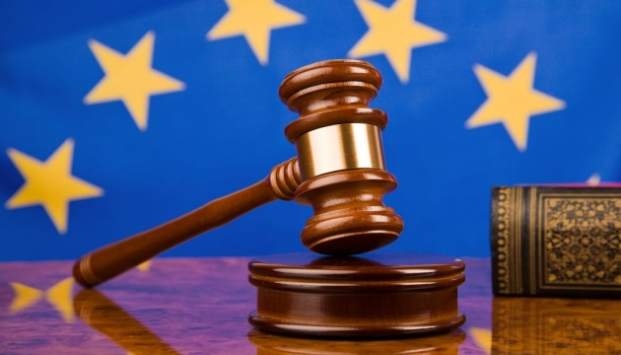
New editions of procedural codes were adopted on October 3, 2017 Law of Ukraine “On Amendments to the Commercial Procedure Code of Ukraine, Civil Procedure Code of Ukraine, Code administrative proceedings of Ukraine ”provide a cardinal step in in the field of electronic access to justice - the creation of a single judiciary information and telecommunication system, which should provide exchange documents in electronic form between courts, between the court and the participants trial, between participants in the trial. It is also established that the court will hear the case in electronic form with the possibility use of electronic evidence.

Slide 13
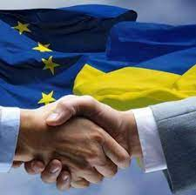
Appointment of judges
A significant and desirable change in the system was the appointment of judges and the introduction guarantees of immutability of judges and cancellation of the former agreement on five-year probationary period. Moreover, the appointment procedure was depoliticized with the removal of parliament from the process, and now the President of Ukraine appoints judges on the basis of submissions from the High Council of Justice. The selection and appointment procedure is based on competition, merit and objective criteria for qualifications, professional skills and integrity.

Slide 14
Thanks for your attention!!!

