Slide 1
Ways of approximation (or harmonization) of ukrainian Commercial Law to the EU Law.
Виконав студент Славницький Андрій
Група Пр (м1) -03

Slide 2
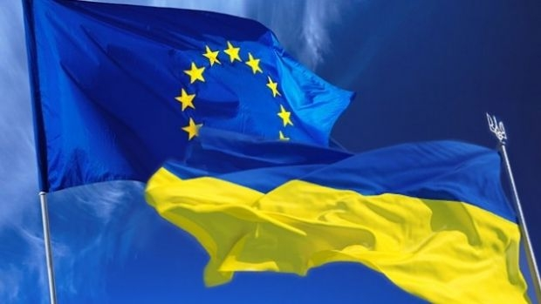
Following the declared European foreign policy vector, it is impossible, in fact, to avoid the
process of adaptation in the internal legal policy of Ukraine. The approximation of Ukrainian
law to the EU acquis communautaire is not only the instrument for deepening our economic
cooperation with the European Union, but also the important measure to enhance further
development of Ukraine in general.

Slide 3
Requirements for further changes in Ukrainian legislation (part 1)
Firstly, Ukraine needs to conduct necessary changes to its legislation to make it fully compatible
with EU legislation listed in the AA and other documents. This requires changes in the existing legal
acts or adoption of new acts. To determine such actions, the drafters of the present Guidelines use
mainly the notion of “approximation”.

Slide 4
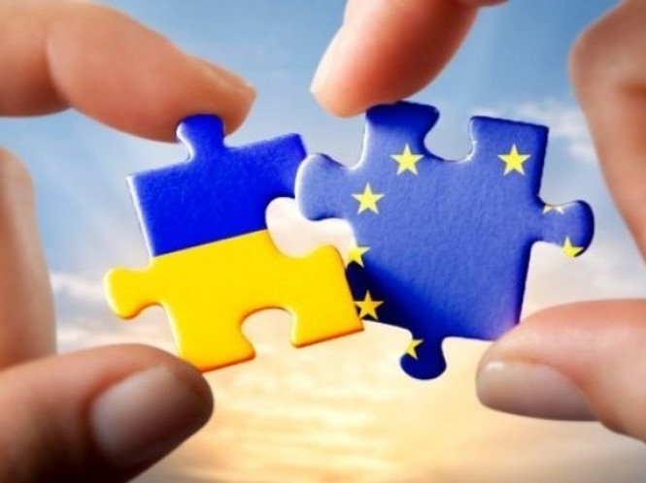
Requirements for further changes in Ukrainian legislation (part 2)
Secondly, Ukrainian authorities also need to make sure that the newly adopted approximated rules are effectively implemented in practice. Such an obligations stems, for instance, from Article 475 (2) of the AA.
It provides that “Monitoring shall include assessments of approximation of Ukrainian law to EU law as defined in this Agreement, including aspects of implementation and enforcement.”
This requires that the drafting of new rules always ensures the applicability of these rules in daily practice. It may include a plethora of non-legislative actions, including securing budgetary appropriations, enhancement of existing state apparatus or creation of new institutions, capacity building exercises for staff of those institutions as well as all other actors involved in law enforcement.

Slide 5
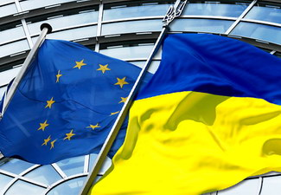
Basic guidelines for further action
At the end of the day, parts of Ukrainian law will be based and modelled on solutions developed in the European Union. Details and deadlines for approximation per area are provided in the AA as well as in other sources, including other bilateral EU-Ukraine agreements.
Although the time framework for approximation is largely determined by the provisions and Annexes of the AA itself, detailed plans and priorities are set in a plethora of road maps and action plans approved by the Ukrainian authorities.
The approximation tasks cover not only EU legal acts but frequently also other sources including soft-law instruments as well as jurisprudence of the Court of Justice of the European Union (CJEU).

